Slide 1
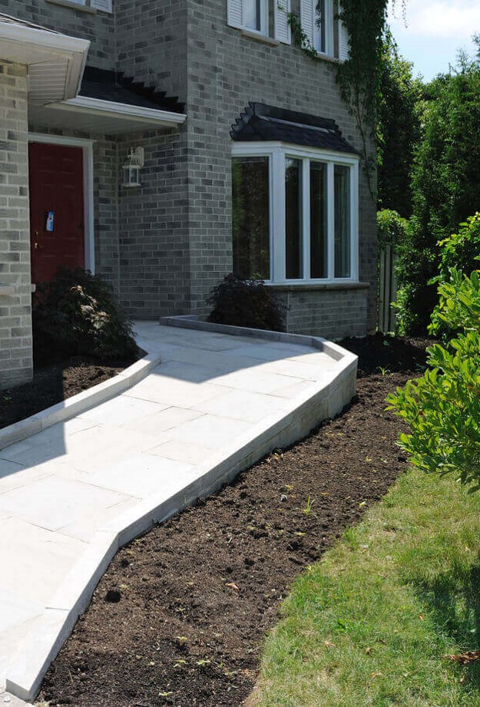
How to Stay in Your Home Longer
Presented by
Leacey E. Brown, M.S.
SDSU Extension Gerontology Field Specialist

Slide 2
Learning Objectives
Describe the growing need for home modification.
Discuss practical, low-cost modification options.
Examine how the home can limit independent living.
Discuss funding & hiring professionals.

Slide 3
Can YOU answer ‘yes’ to all six questions?
Does your home have at least one no-step entrance?
Does the main floor have extra-wide hallways (minimum 48”) and doors (minimum 36”)?
Does the main floor have lever-style handles on doors and faucets?
Does the main floor have a bathroom shower that has no barrier and can fit a wheelchair?
Can the main floor electrical controls and outlets be reached from a seated position?
Does the main floor have a bedroom or a room that can be used for sleeping?
Notes:
Ask the audience answer each of the six questions on the screen.
Read each question.
Yes to all 6?
Did you build your own home?
Did you inherit your home from an older relative?
Home show and USS Wacipi Result
many participants (79%) will need to make some kind of renovation or even relocate to alternative housing once someone in their household develops a disability.
This data also suggests that individuals who need to relocate to alternative housing because of a disability may experience difficulties finding a new home that meets their needs.
Emphasis: what happens if someone in your life becomes a wheelchair user?

Slide 4
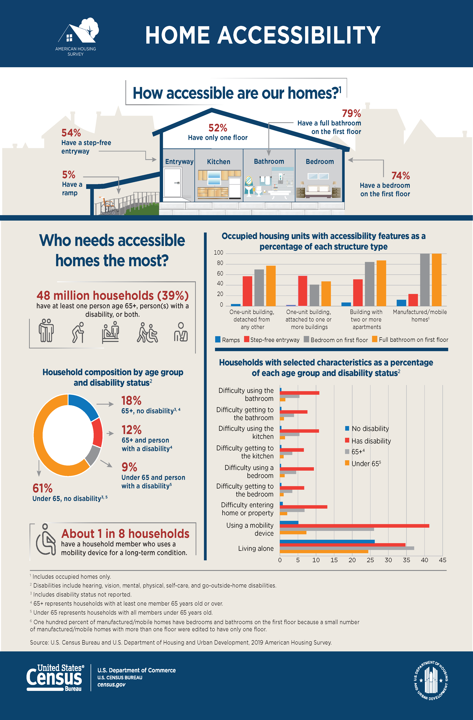
Source: https://www.census.gov/library/visualizations/2021/demo/2019-home-accessibility.html

Slide 5
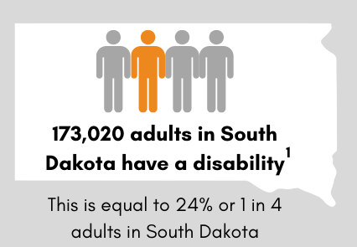
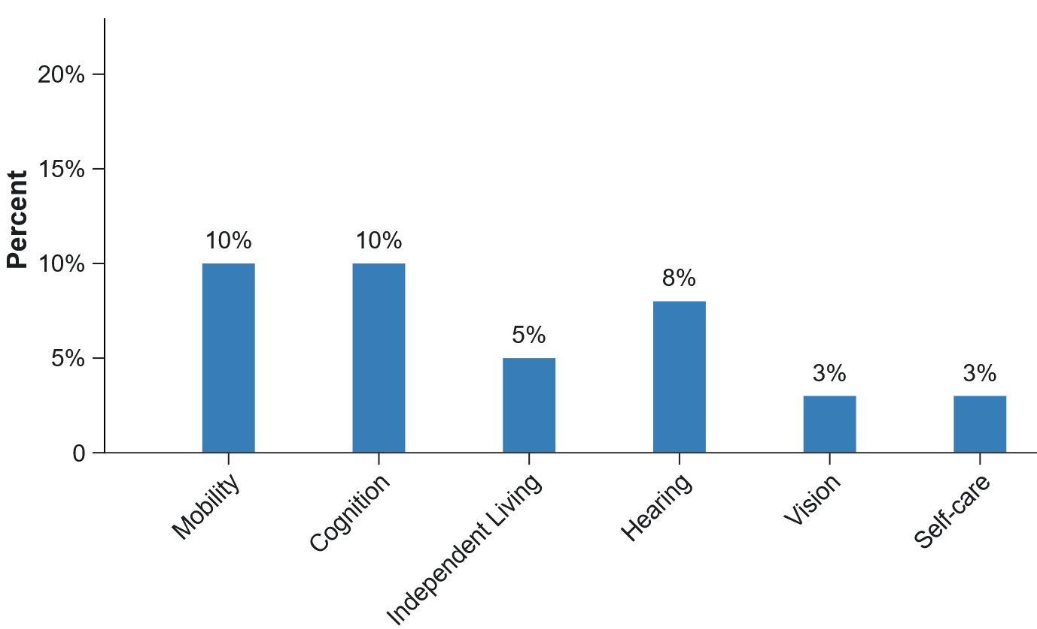
Disabilities in SD (2022)
Source: https://www.cdc.gov/dhds/impacts/index.html

Slide 6
Facts of Life
Chronic Diseases
Accidents
Death & Dying
Illness & Recovery
Aging & Frailty
Notes:
There are many factors that could make aging in place difficult, such as.
Chronic disease
Accidents
Terminal illness
Illness & Recovery
Aging and frailty
All of these events can create short-term or long-term disabilities.
Short-term recovery
Lifelong disability
Accessibility in the home can become a major barrier to remaining in the home.

Slide 7
What might prevent someone from remaining in the home?
Access to services and supports
Access to transportation
Availability of family caregiver
Lack of planning ahead
Design of the community
Design of the home

Slide 8
What are home modifications?
Ramp
Bathroom
Grab Bars
Reorganization
Renovations or changes made in the home to improve its function for people with disabilities.
Notes:
Home modifications are renovations or changes made in the home to meet the needs of people with disabilities. Some renovations are simple solutions that are low cost and easy. Other home improvements requirement people are more costly and require people with the right skills and tools.
Common examples include
Ramp
Grab bars
Bathroom remodel
Home modifications can include other changes
Moving the sleeping area to the main level
Reorganizing storage to make it easier to get items you need daily

Slide 9
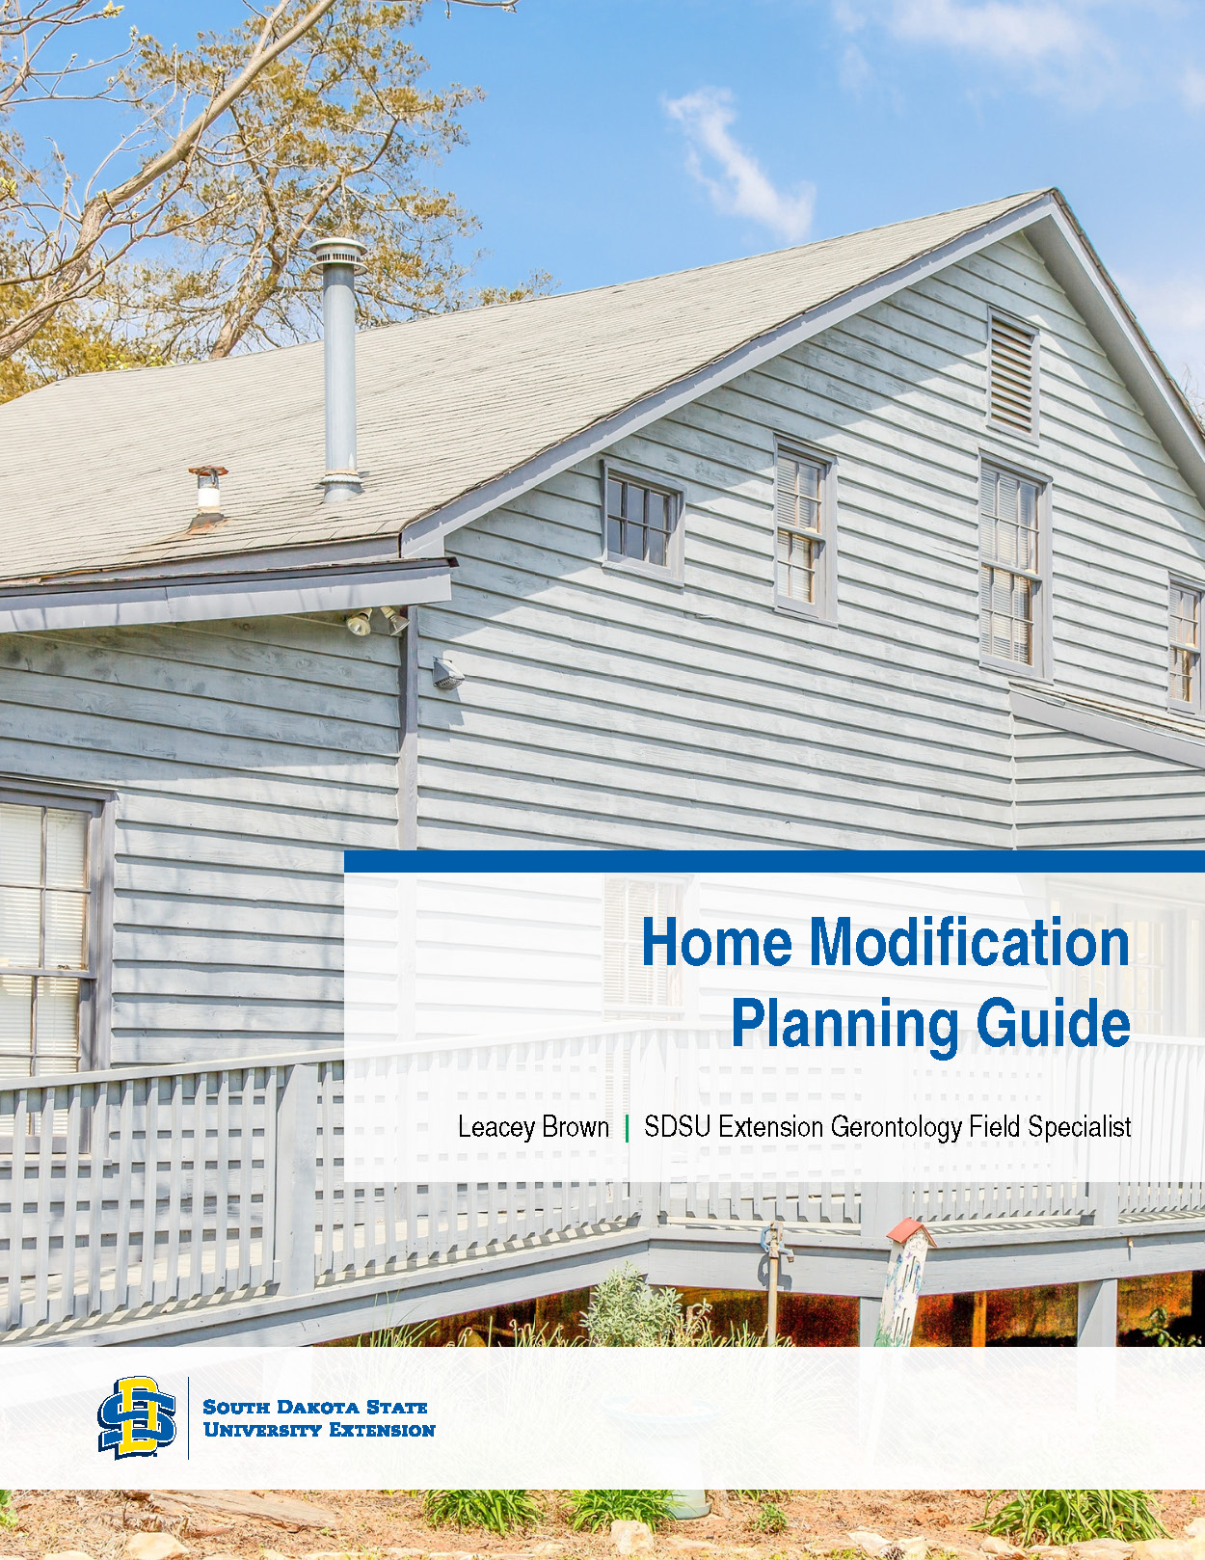
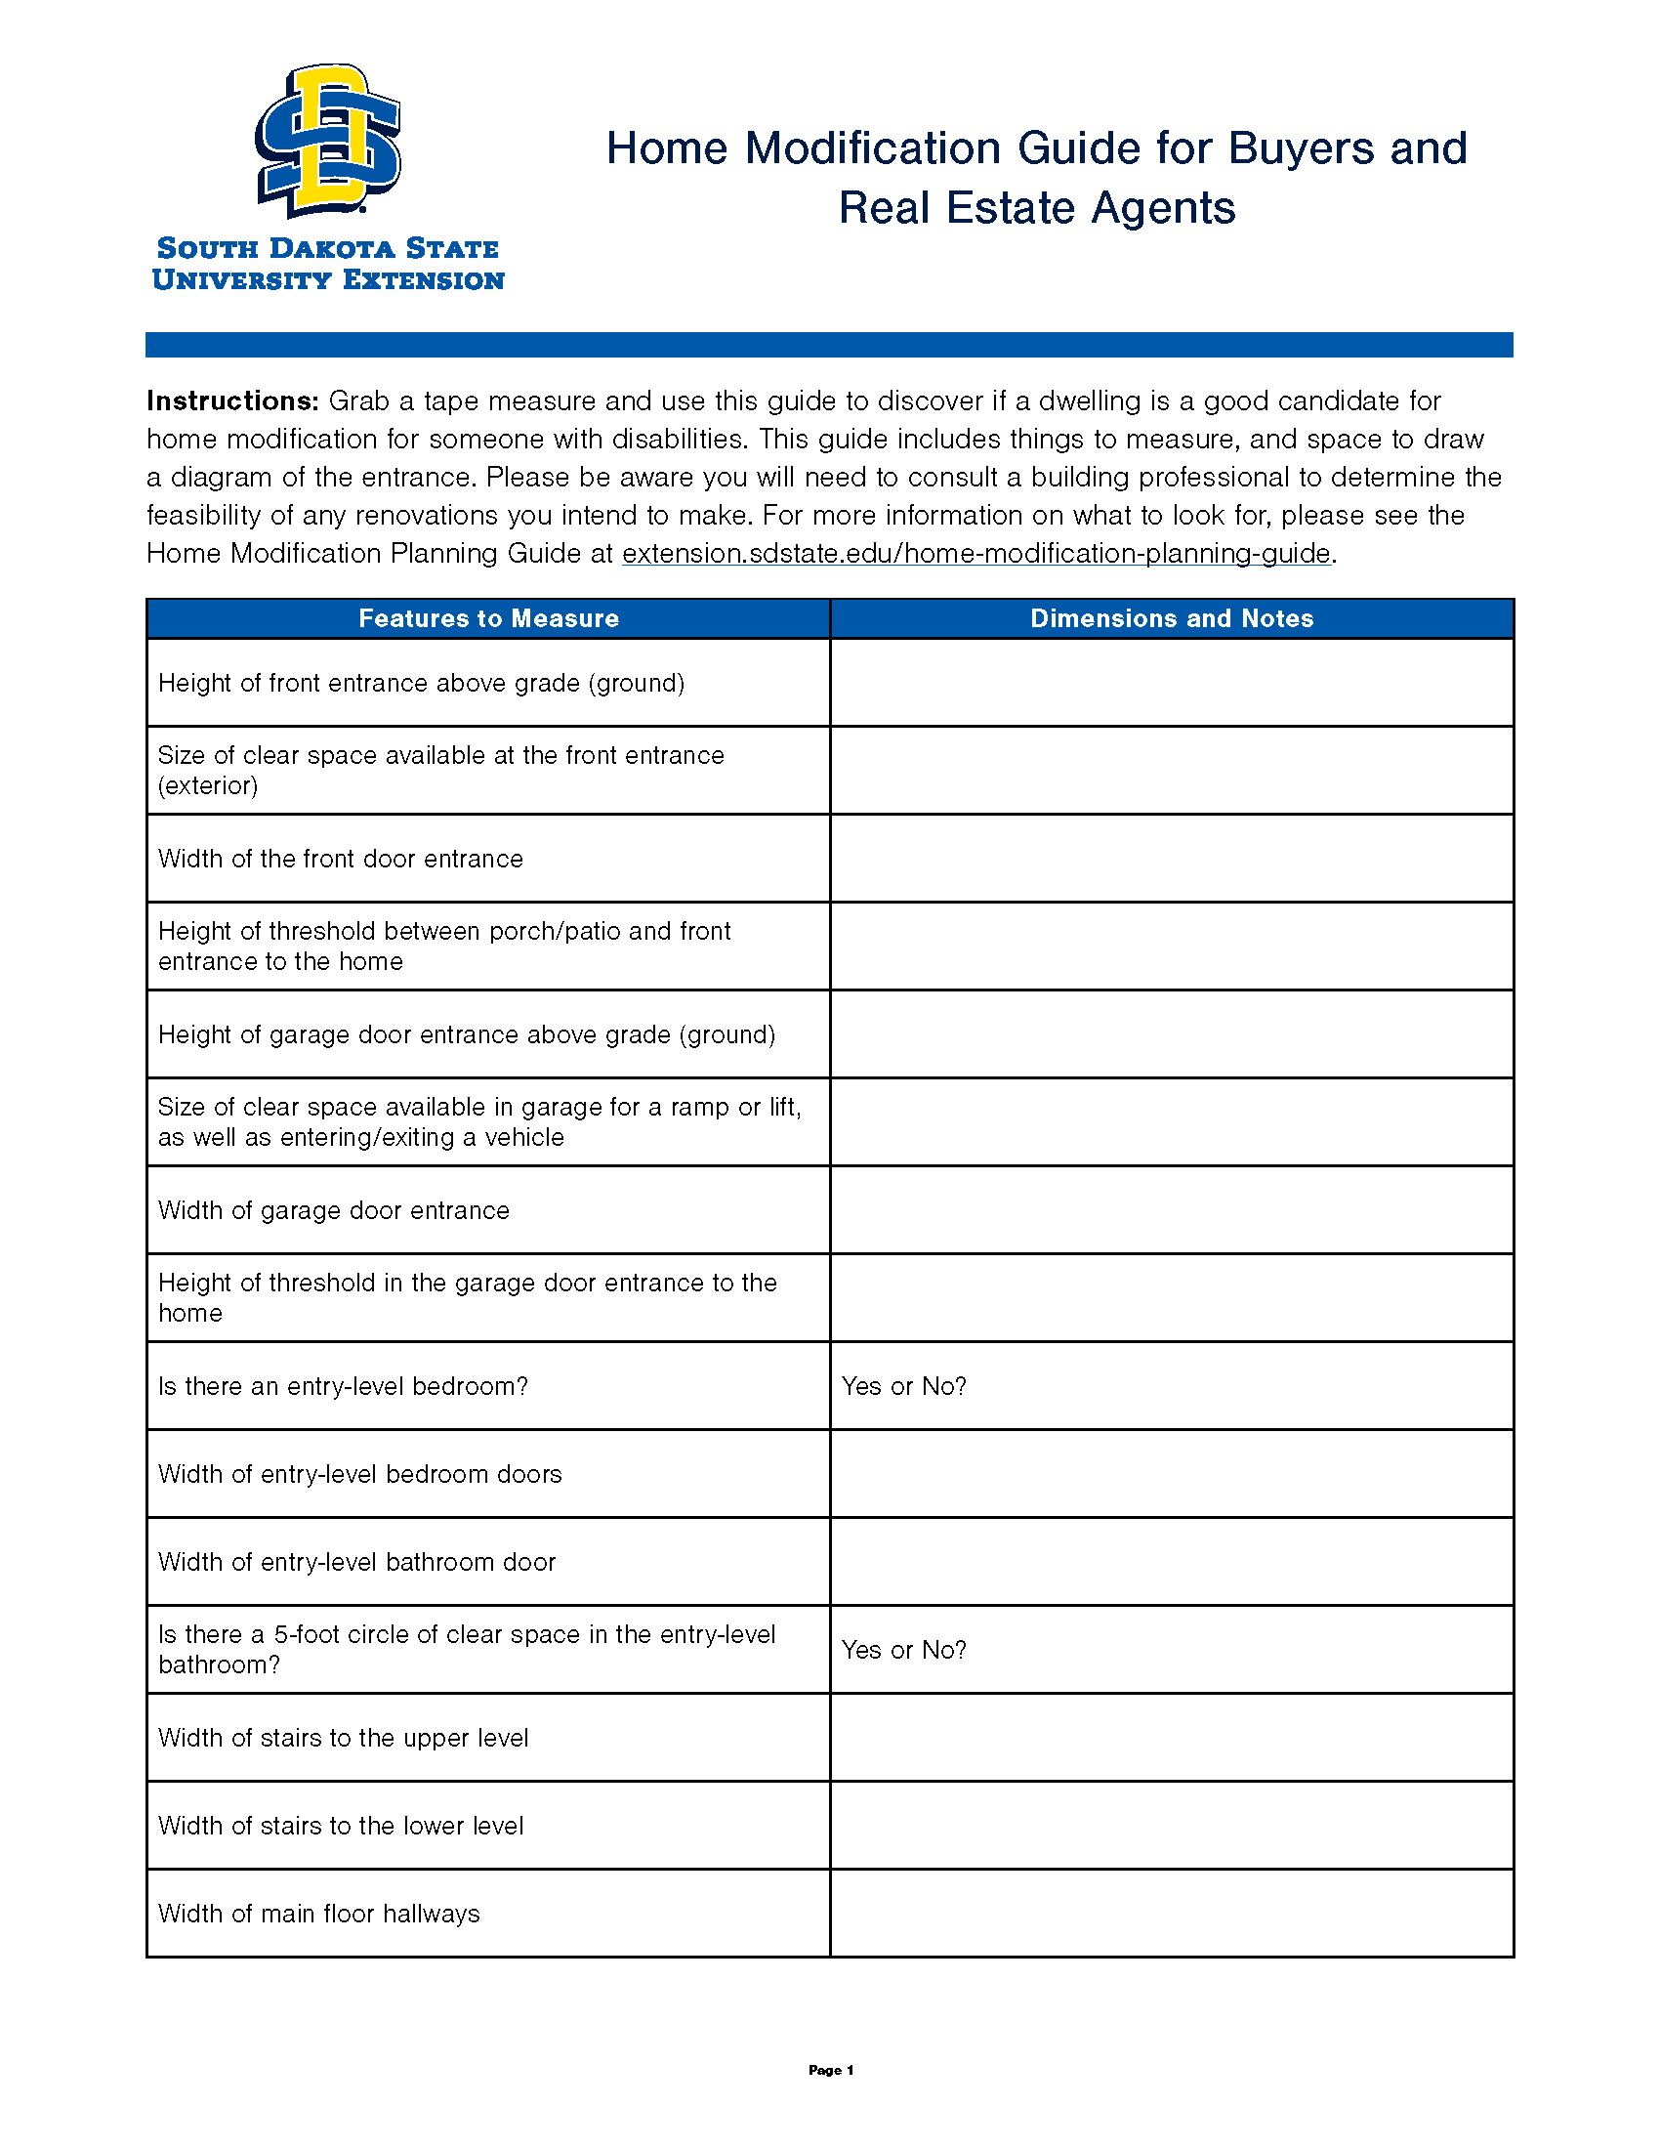

Home Modification Planning Guides

Slide 10
Practical, Low-Cost Fixes
Improve lighting and color contrast
Remove throw rugs
Downsize, declutter, and rearrange furniture
Reorganize storage
Use non-slip mats and adhesive strips
Use lever‑style handles for doors and faucets
Install grab bars
Notes:
Be sure to mention downsizing

Slide 11
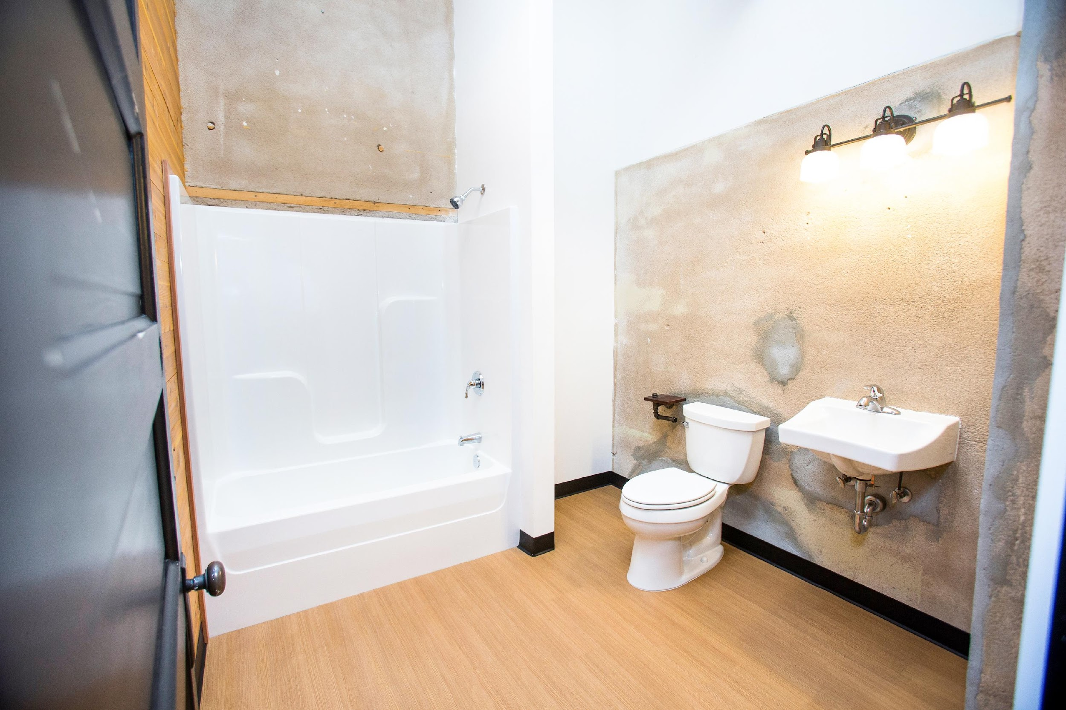
Barriers to Home Modification
Cost
Time
Deferred maintenance
Availability of providers
Socioeconomic status
Rurality
Consumer knowledge & perceptions
Architectural
Notes:
Cost
Time
deferred maintenance
Availability of providers
Socioeconomic Status
Rurality
Consumer knowledge and perceptions
belief that Medicare pays nursing home costs
grab bar and ramp resistances
Architectural
Split foyer

Slide 12
Searching for Professionals
Key Terms
Accessible design
Adaptable design
Barrier-free design
Home modification
Inclusive design
Universal design
Usable design
Visitability/Visitable
Certifications/Trainings
Certified Environmental Access Consultants (CEAC)
Certified Aging in Place Specialist (CAPS)
Executive Certificate in Home Modification Program (University of Southern California)
Senior Home Safety Specialist (Age Safe America)
Certified Home Assessment and Modification Professional (CHAMPS)

Slide 13
Options for loans, grants, and programs
Bank loan products
Centers for Independent Living
Community Development Block Grants
Dakota at Home
Dakota Link
Federal Housing Administration
Helpline Center
South Dakota Housing
US Department of Housing and Urban Development
USDA Office of Rural Development
Department of Veterans Affairs (VA)
Source: https://homemods.org/directory-state/sd/

Slide 14
Important Costs to Consider
We will eventually need assistance with maintaining our homes.
Who will help with routine home maintenance & repairs?
Hiring paid help is necessary as abilities change.
General household cleaning tasks
Cleaning gutters and downspouts
Clearing snow and ice from walkways and driveways
Flushing the water heater to remove sediment buildup
Fixing wobbly steps, loose deck boards, or railing issues
And more!!!!!
Notes:
Main idea: To stay in your home longer, plan to pay for support/services and ongoing home maintenance.

Slide 15
What about renters?
Reasonable accommodations and reasonable modifications for individuals with disabilities.
  The Fair Housing Act
  Section 504
  Americans with Disabilities Act
Contact your landlord to request home modifications.
Learn More: https://www.hud.gov/

Slide 16

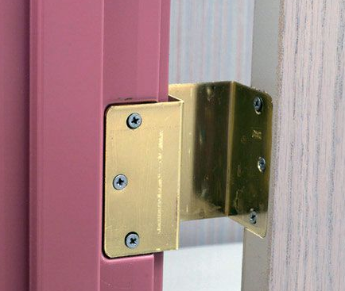
Things To Remember
Home modifications may address safety concerns, improve functional performance, reduce risk of falls, and reduce demand on caregiver.
It needs to be customized to the individual.
Professionals can help find the right home modifications.
  Building Professional
  Health Care Professional
Home modifications are not always structural.
Adaptive equipment and technology are part of home modification.
Expandable Offset Door Hinge
Photo Credits: Susan Ray-Degges
Notes:
Benefits of home modifications
Improve functional performance
Reduce risk of falls
Reduce demand on caregiver
One size does not fit all
structural features versus home
Talk about the role of medical and building professionals.
Home modification is not always structural, especially if home was constructed with key features (bathroom).
Talk about adaptive equipment and technology
Wireless switches
Expandable offset door hinge

Slide 17

Upstream Prevention
Notes:
How can we make things different for future generations?
Embrace disability as a normal and natural part of the human life course.
The fountain of youth is a myth.
Improving how we age is possible with creativity and innovation.
Individuals and families will have to find alternative solutions to caregiving across the lifespan.

Slide 18
Alternative Options for Individuals and Families
Housing costs
Childcare costs
Long-term care costs
Intergenerational living
Cohousing

Slide 19


Adaptable Home
Bonus Feature: 42” wide stairs
On grade entry or adaptable to grade with ramp.
A bathroom sized and spaced for a wheelchair user.
A bedroom or room that could be used for sleep on the entry level.
Wide hallways (42”) and doors (36”).
Source: https://extension.sdstate.edu/adaptable-home-overview
Notes:
Primary goal of adaptability
Ensure access to essential features (accessible bathroom and a sleeping space).
Reduce costs associated with accessibility renovations.
Name the 4 main features
These structural features are the most difficult and costly to renovate to accessibility.
Building bedroom or bathroom on entrance level
Hall/door width
Benefits of wide stairs
Enhances capacity of emergency services professionals to help someone in need.
Include 1) blocking (i.e., extra wood behind drywall that allows you to mount assistive technology) and 2) electrical access so a stair glider can be installed later.
Provided expanded comments about doors/halls on this slide.
No-step threshold for interior and exterior doors.
Decks and porches
New construction versus existing units (i.e., making essential doors 36 inches).
Ensure access to essential features (bedroom and bathroom)
Make essential doors 36 inches (bathroom and accessible entrance)

Slide 20
Summary
It is likely that your home is missing basic accessibility features.
Every individual and family can expect to be impacted by disabilities in the home.
Home modification refers to renovations or changes that improve function of the home for people with disabilities.
Families are well served to plan early for home modification.
Notes:
Willingness to pay for services and repairs and living in single-family housing
The aim is to help people live easily and comfortably in their homes and communities as they age. The process is based on the WHO’s 8 domains of livability which are housing, outdoor spaces and building, transportation, communication and information, civic participation and employment, respect and social inclusion, health services and community supports, and social participation.
Here are some factors to consider:
Access to services and supports – health problems
Access to transportation – ability to drive
Availability of family caregiver – do they live nearby? Especially if you live along
Lack of planning ahead
Design of the community - is it safe, can you get around, are there recreational areas, are there sidewalks for walking
Design of the home
This presentation is focused on how design of the home can mitigate the challenges associated with the facts of life.

Slide 21
Learn More
Adaptable Home Overview https://extension.sdstate.edu/adaptable-home-overview
Home Modification Planning Guides https://extension.sdstate.edu/home-modification-planning-guides
Testimonials for Home Modification https://extension.sdstate.edu/testimonials-home-modification
Voices for Home Modification of the Dakotas https://extension.sdstate.edu/voices-home-modification-dakotas
Find Help
Dakota at Home https://dhs.sd.gov/en/ltss/dakota-at-home
Helpline Center https://www.helplinecenter.org/

Slide 22
Contact Information
Leacey E. Brown, M.S.
SDSU Extension Gerontology Field Specialist
Phone: (605) 394-1722
Leacey.Brown@SDState.edu
https://extension.sdstate.edu/wellness/older-adults

