Slide 1
Parkinson's and Mental Health: Not All Symptoms Shake
Katherine Bice, CSW-PIP, QMHP
April 25, 2026

Slide 2
Agenda
stigma
Depression
Apathy
Anxiety
Caregiver Mental Health
Self-Care
Resources
Q&A

Slide 3
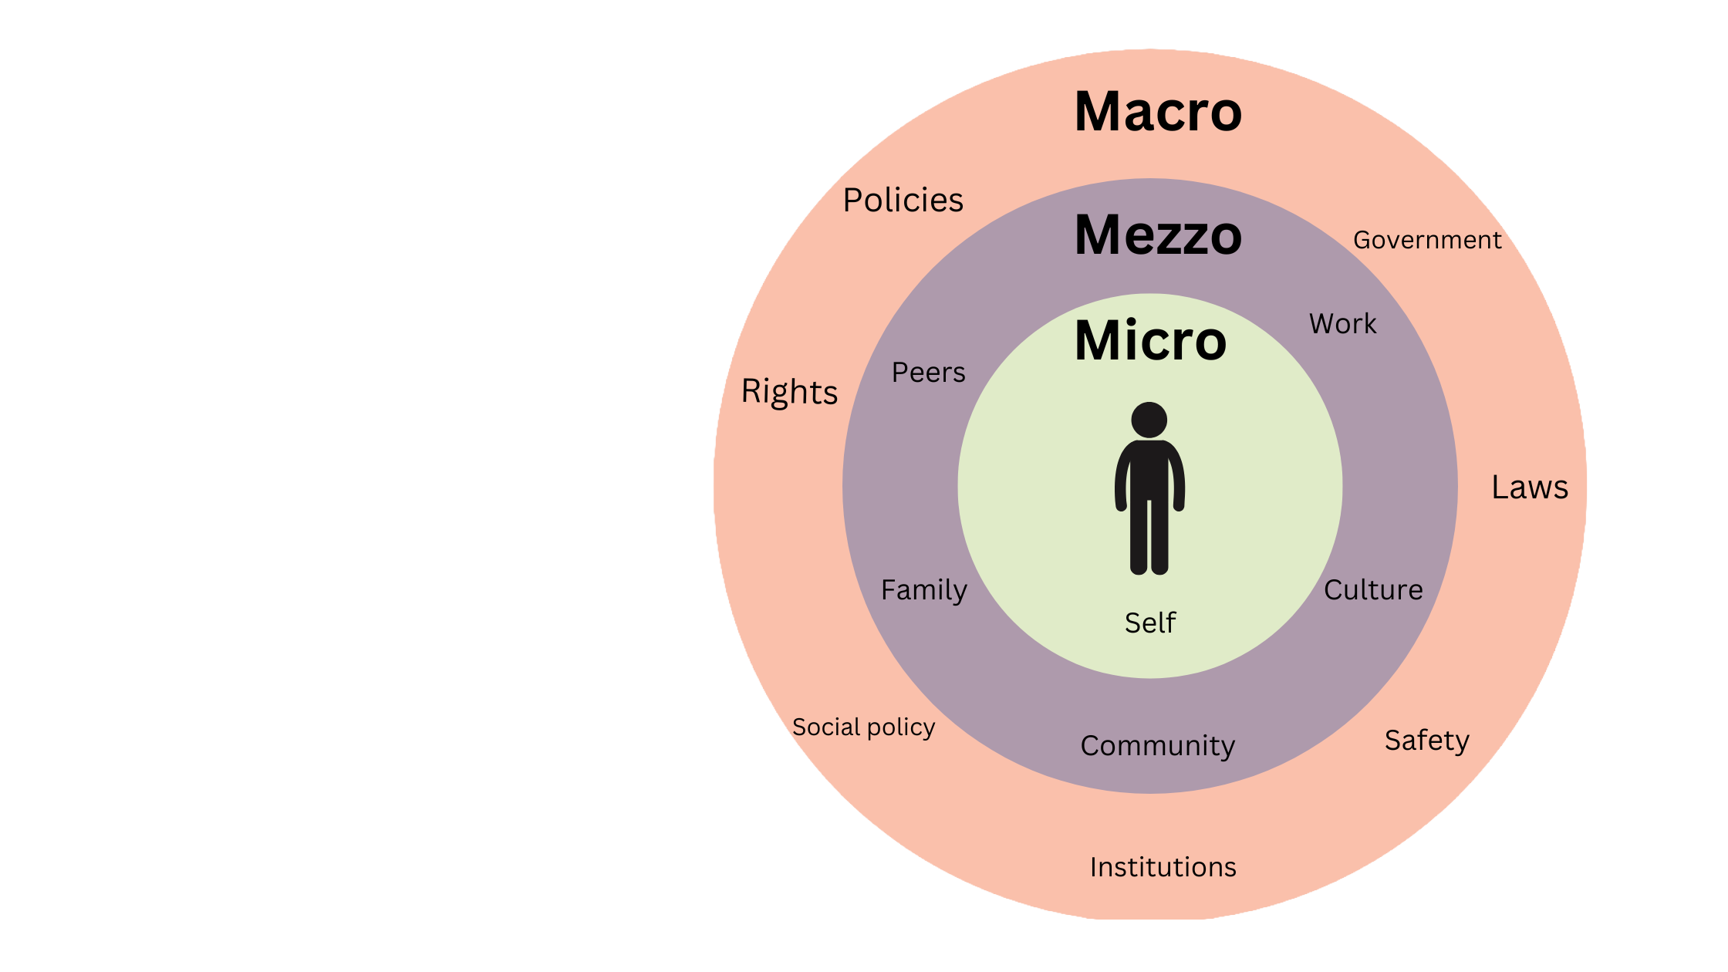
Not Just a Diagnosis
Figure 1
Notes:
“MSW Helper.” MSW Helper, 18 May 2024, www.mswhelper.com/blog/3-main-social-work-theories-you-should-know-before-applying-to-msw-foundational-social-work-theories.

Slide 4
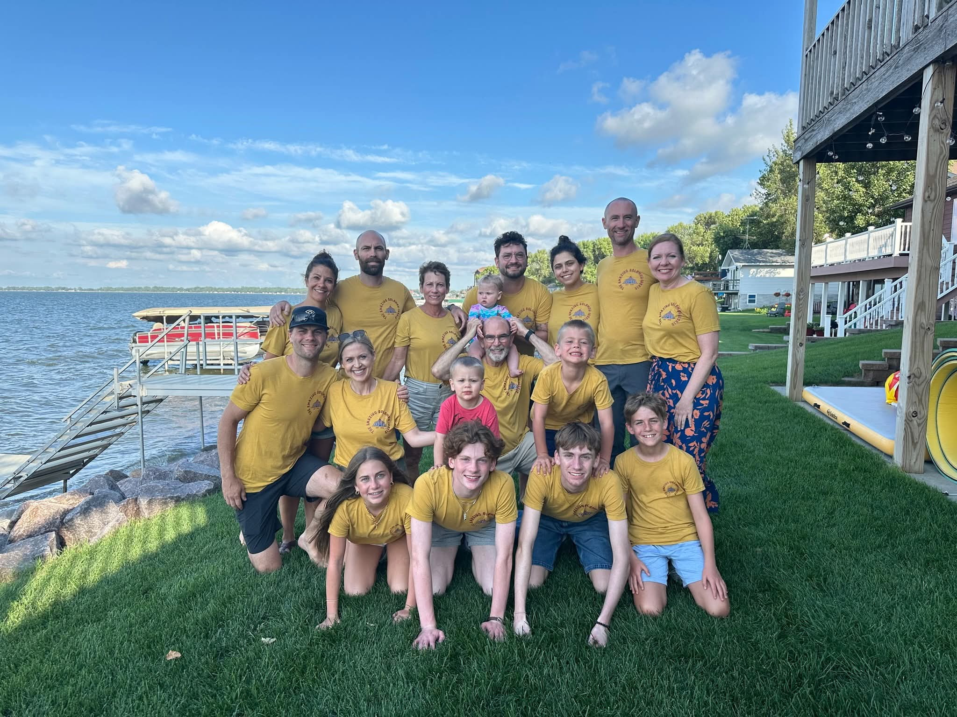
The Amazing Solomoninskis
"Are you not entertained?"

Slide 5
"People are moved by stories, not statistics."
-Jane Goodall

Slide 6
Research estimates that at least 50% of people with PD will experience some form of depression during their Parkinson's journey.
Up to 40% will experience an anxiety disorder.
(National Parkinson's Foundation)
Notes:
Emotional & Mental Health. Parkinson’s Foundation. (n.d.). https://www.parkinson.org/living-with-parkinsons/emotional-mental-health

Slide 7
Research estimates that the depression rate among caregivers of patients with PD ranges from 14% to 35%.
(Lee et al., 2022)
Notes:
Lee, Y., Chang, Y.-Y., Chen, Y.-F., Lin, T.-K., Hung, C.-F., Chiou, Y.-J., & Wang, L.-J. (2022). Prevalence and Risk Factors of Depression between Patients with Parkinson’s Disease and Their Caregivers: A One-Year Prospective Study. Healthcare, 10(7), 1305. https://doi.org/10.3390/healthcare10071305

Slide 8
Stigma
"Not all symptoms shake"
More than 50% of people with PD conceal their diagnosis, mask symptoms, or avoid appearing in public due to stigma.
(Crooks et al., 2025)
Notes:
Crooks, S., Mitchell, G., Wynne, L., & Carter, G. (2025, January 3). Exploring the Stigma Experienced by People
Affected by Parkinson’s Disease: A Systematic Review. BMC public health. https://pmc.ncbi.nlm.nih.gov/articles/PMC11697948/

Slide 9
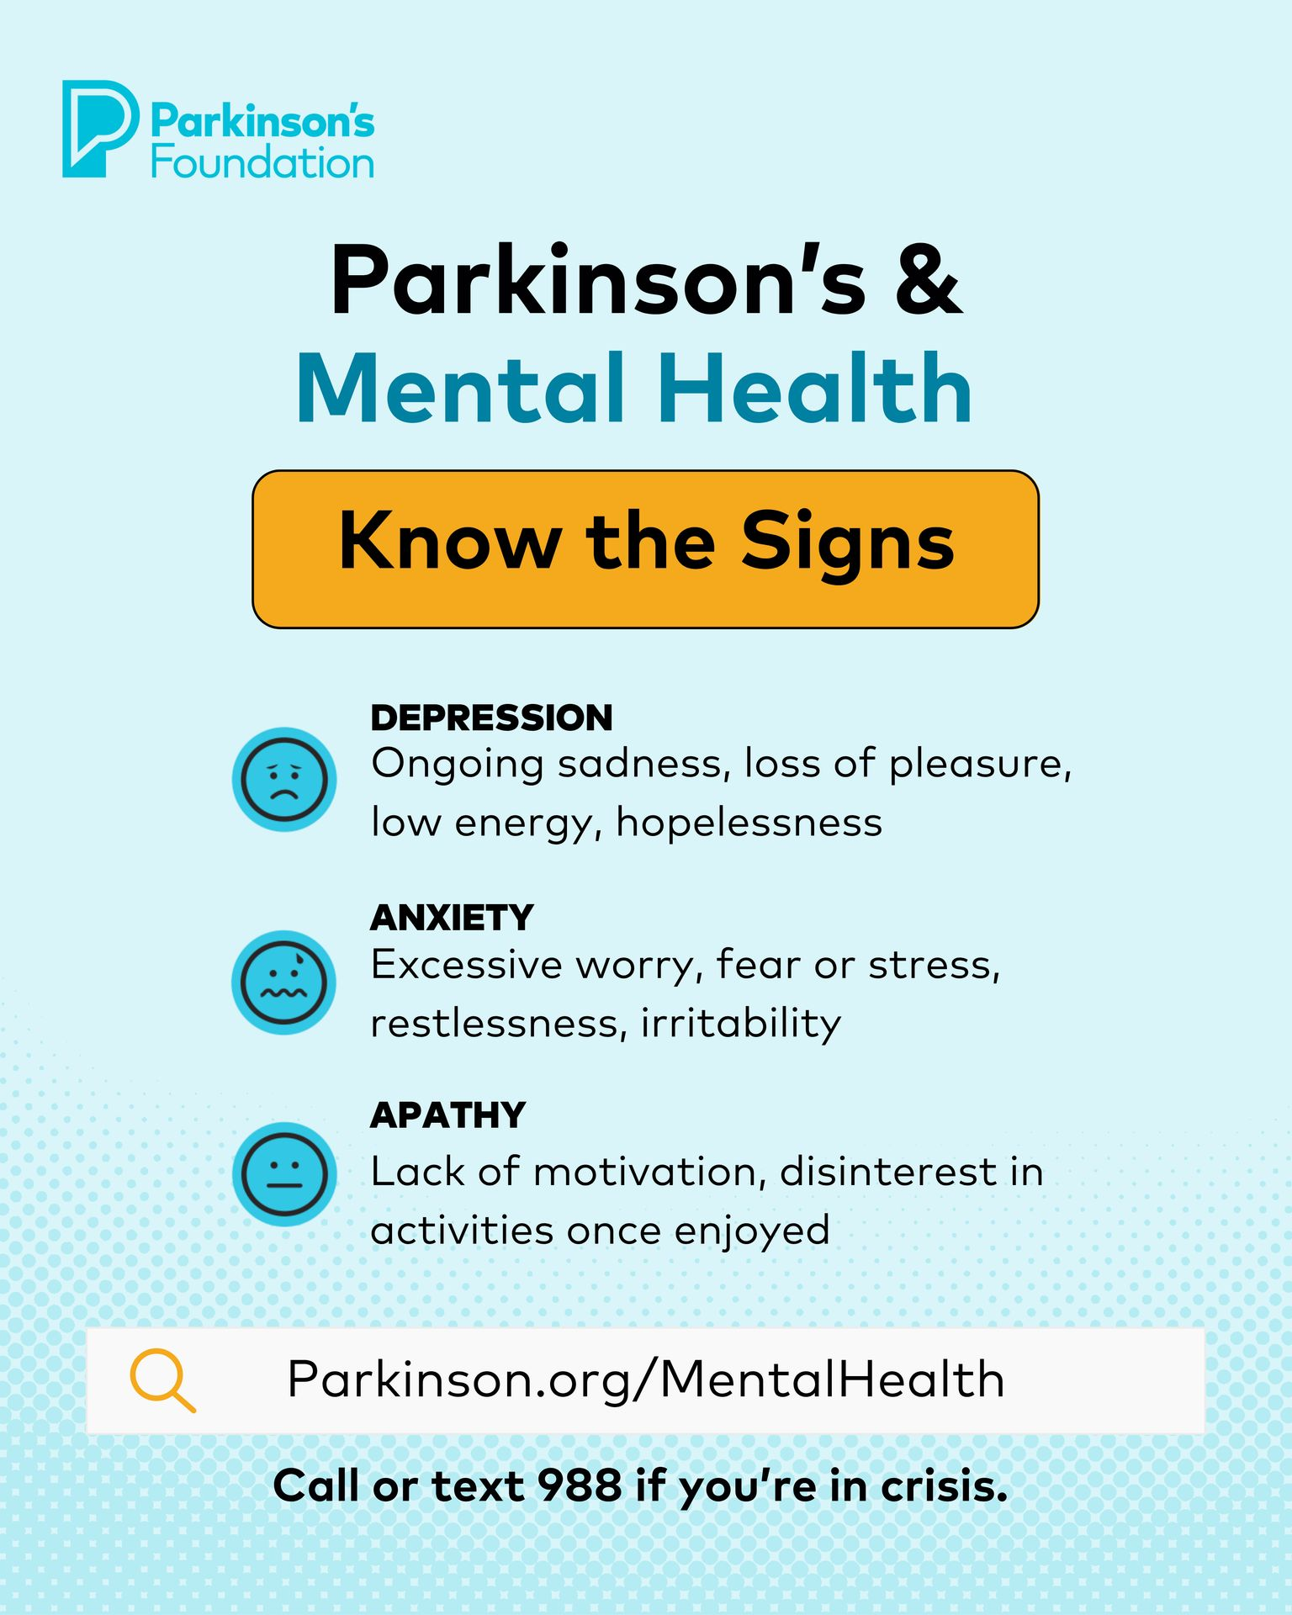
Figure 2
Notes:
Parkinson.org/MentalHealth

Slide 10
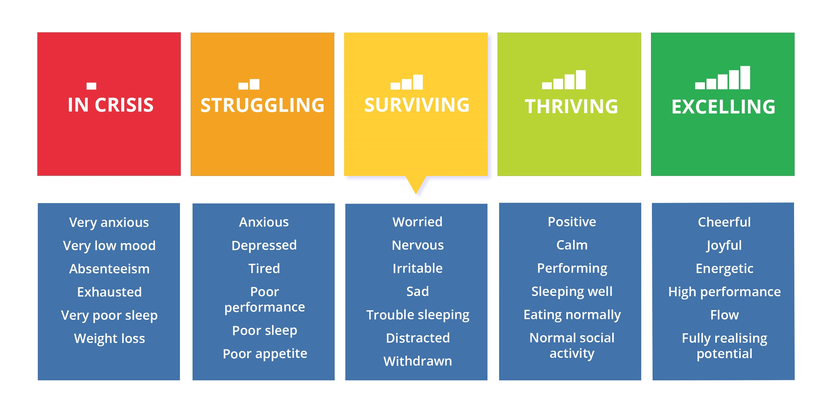
Mental Health as a Continuum
Figure 3
Notes:
Delphis. “The Mental Health Continuum Is a Better Model for Mental Health.” Delphis Learning, 2020,
https://delphis.org.uk/mental-health/continuum-mental-health/

Slide 11
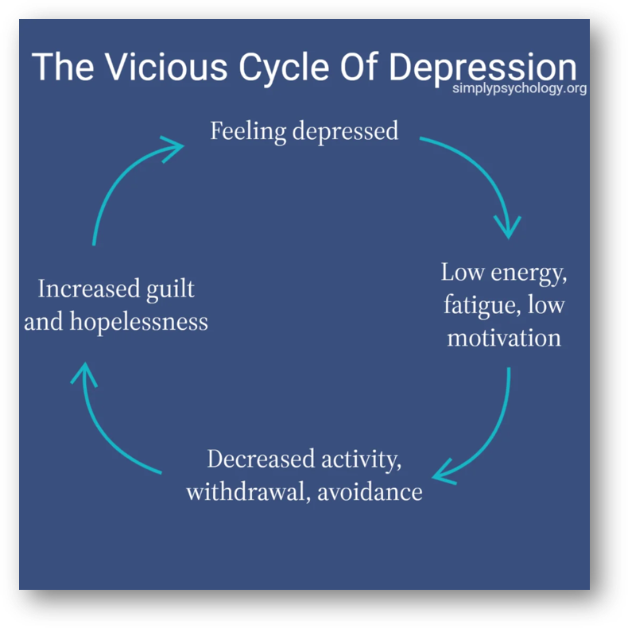
Figure 4
Notes:
Guy-Evans, Olivia. “The Various Types of Mood Disorders.” Www.simplypsychology.org, 9 Nov. 2023, www.simplypsychology.org/mood-disorder.html.

Slide 12
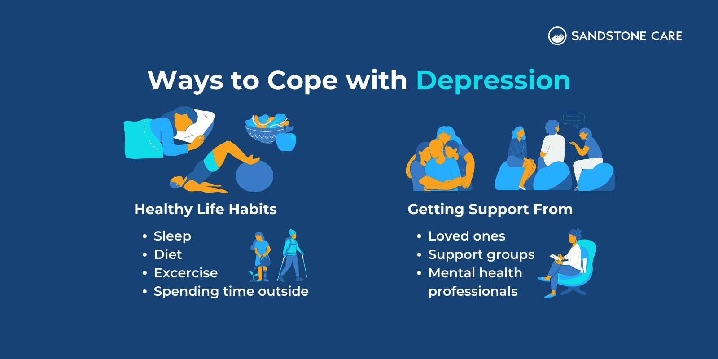
Figure 5
Notes:
Quinn, Deborah. “How to Help Someone with Depression.” Sandstone Care, 19 Apr. 2023, www.sandstonecare.com/blog/how-to-help-someone-with-depression/.

Slide 13
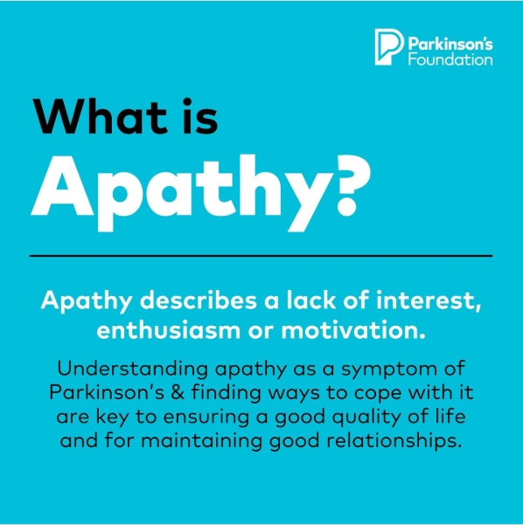
Figure 6
Notes:
Parkinson.org/MentalHealth

Slide 14
Apathy can show up in three ways:
• Cognitive. Loss of interest/curiosity in new things.
• Emotional. A lack of passion or reaction to news or situations that normally would evoke an emotion.
• Behavioral. Trouble initiating activity, a need for others to prompt one to complete tasks.
(National Parkinson's Foundation)
Notes:
Apathy and PD | Parkinson’s Foundation. (n.d.). Www.parkinson.org. https://www.parkinson.org/library/fact-sheets/apathy

Slide 15
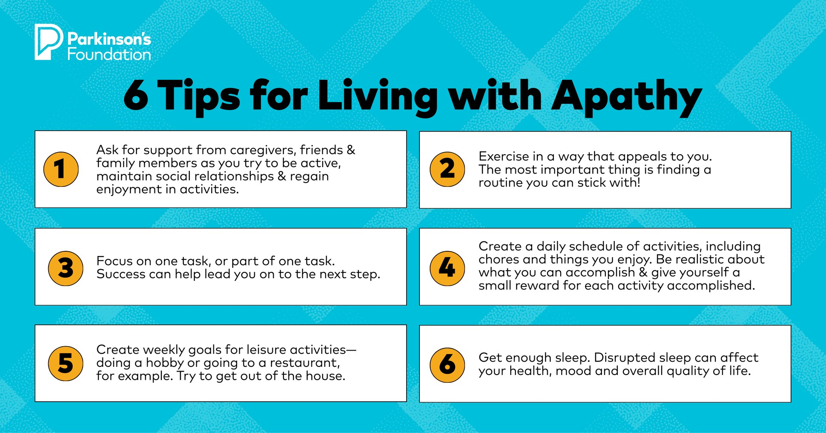
Figure 7
Notes:
Parkinson.org/MentalHealth

Slide 16
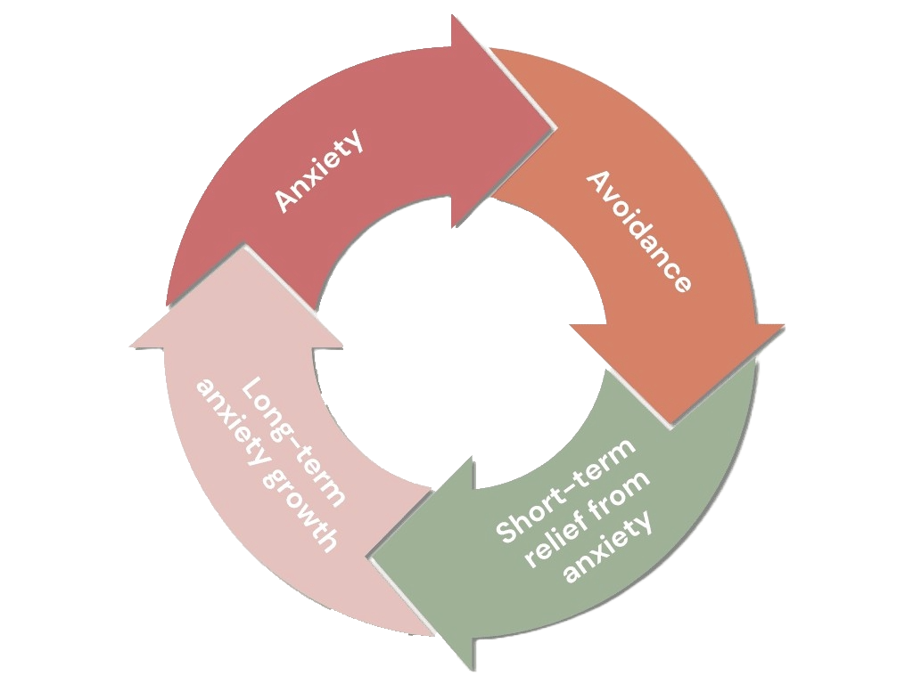
Cycle of Anxiety
Figure 8

Slide 17
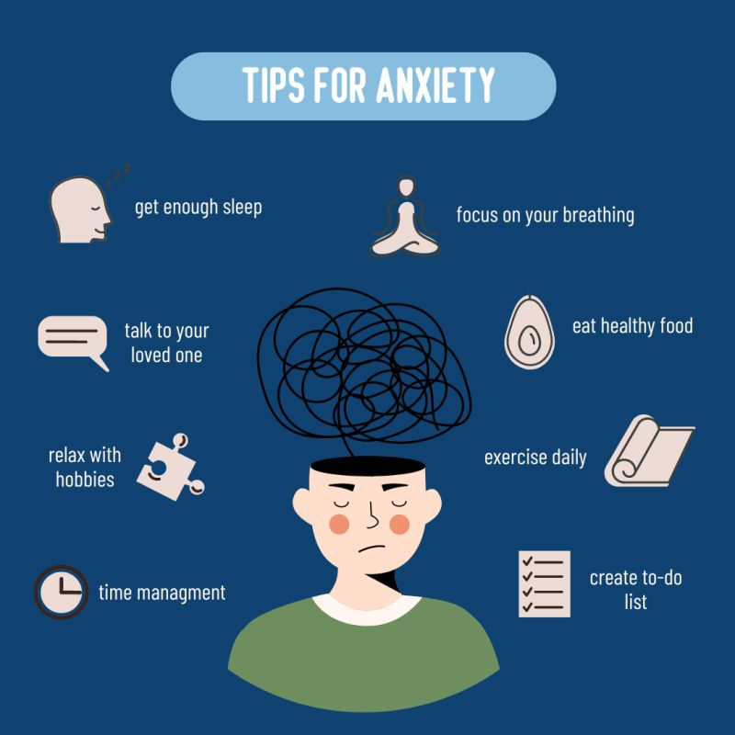
Figure 9

Slide 18
Caregivers

Slide 19
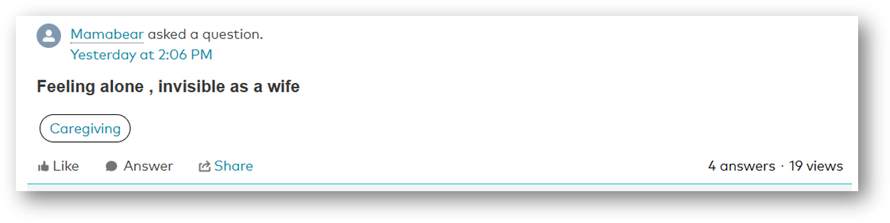

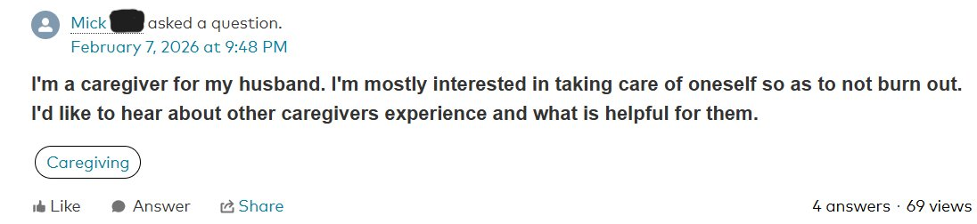
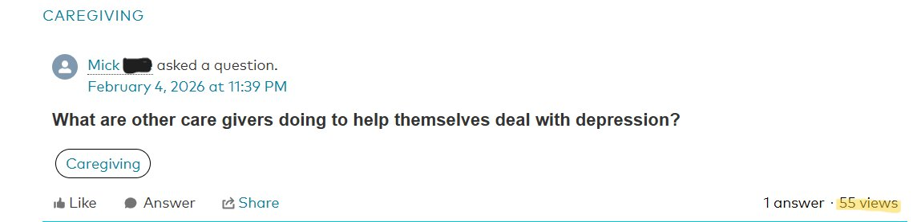
(National Parkinson's Foundation)

Slide 20
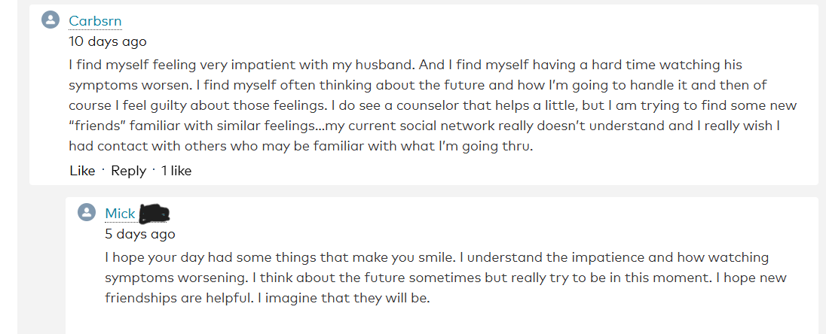
(National Parkinson's Foundation)

Slide 21
Anticipatory Grief

Slide 22
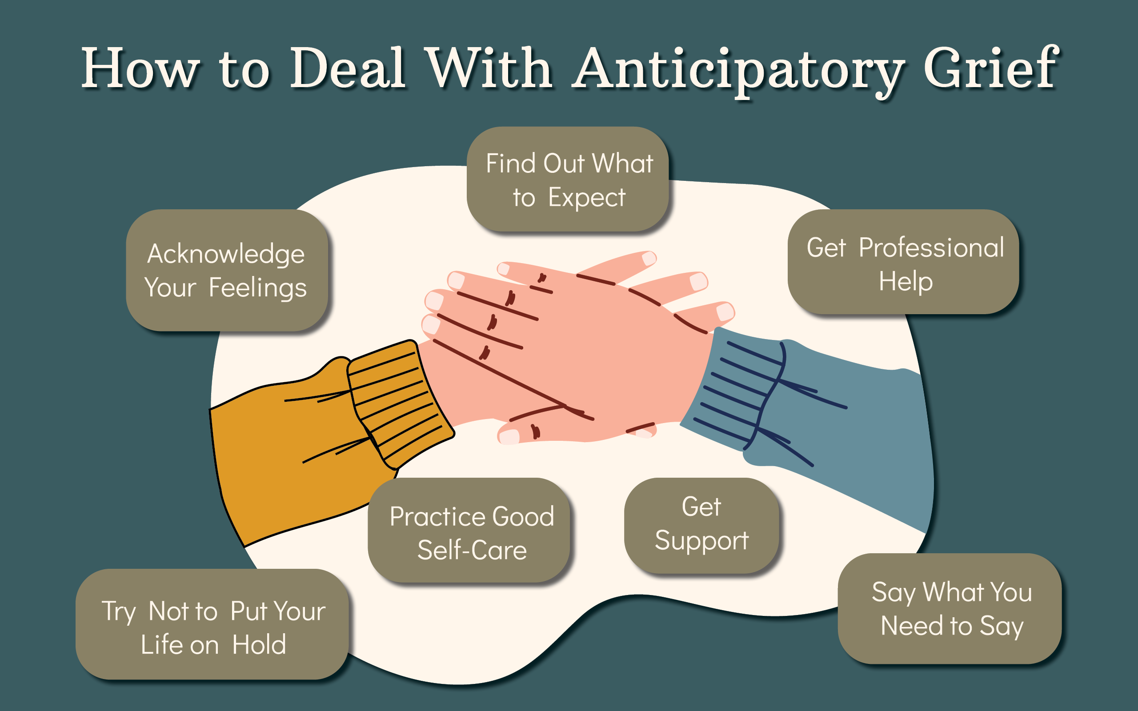
Figure 10
Notes:
Pinches, Julie. “How to Deal with Anticipatory Grief – Barn Life.” Barn Life Recovery, 26 July 2023, barnliferecovery.com/how-to-deal-with-anticipatory-grief/.

Slide 23
Self-Care

Slide 24
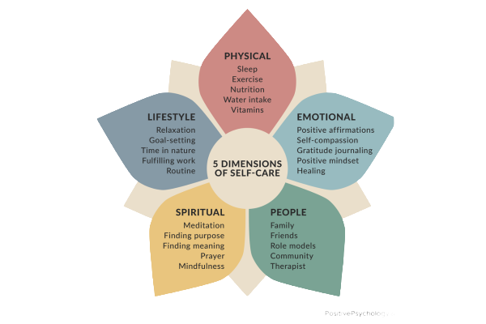
Figure 11
Notes:
“The Five Dimensions of Self Care.” Thecuriouswolf.co.uk, 2024, thecuriouswolf.co.uk/post/the-five-dimensions-of-self-care. Accessed 10 Apr. 2026.

Slide 25
Benefits of Self-Care
Short term:
  Reduced stress levels
  increased self-worth
  overall feeling of belonging
Long term:
  Management of chronic conditions
  healthier relationships
  reduced burn out
  overall improvement in quality of life
(Carver et al., 2010)
Notes:
Carver, C. S., Scheier, M. F., & Segerstrom, S. C. (2010a). Optimism. Clinical Psychology Review, 30(7), 879–889. https://doi.org/10.1016/j.cpr.2010.01.006

Slide 26

Counseling

Slide 27
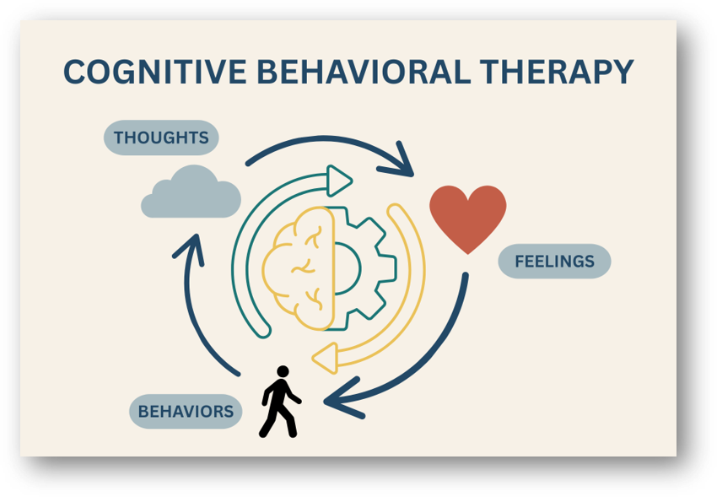
Figure 12
Notes:
McPherson, Dana. “Aspire Psychology.” Aspire Psychology, 19 July 2025, www.aspirepsychologyportland.com/our-blog/what-is-cognitive-behavioral-therapy.

Slide 28
Search for a Counselor
Psychologytoday.Com
Filters:
  Chronic Illness
  Geriatric
  Spirituality/religion
  Depression, anxiety, stress

Slide 29
Resources
Parkinson's Foundation
  National Helpline
    1-800-4PD-INFO (1-800-473-4636)
      Answers to PD questions
      Caregiver resources
The Helpline Center, 988

Slide 30
South Dakota Parkinson's Foundation
https://www.southdakotaparkinson.org/support-groups
  Support groups listed throughout the state
    Men's, Women's, and Caregiver groups available

Slide 31
Hope & Optimism

Slide 32
Hope is about leaving room for something good to happen. Optimism is about having hope, trusting that things will work out.
Notes:
The Healing Power of Hope and Optimism. 15 June 2020.

Slide 33

Thank you

Slide 34
Citations
13 Coping Skills for Anxiety That Actually Work. (2026, January 22). Springhealth.com; Spring Health. https://www.springhealth.com/blog/coping-skills-for-anxiety
Anxiety and PD | Parkinson’s Foundation. (n.d.). https://www.parkinson.org/library/fact-sheets/anxiety
Apathy and PD | Parkinson’s Foundation. (n.d.). https://www.parkinson.org/library/fact- sheets/apathy
Bottaro, Angelica. “What Is Self-Care and Why Is It Important?” Verywell Health, 2023, www.verywellhealth.com/what-is-self-care-5212781.
Carpenter, Chrissy. “Care for the Caregiver: Care Counseling.” Caregiver Action Network, 12 June 2024, www.caregiveraction.org/care-caregiver-care-counseling/.
Carver, C. S., Scheier, M. F., & Segerstrom, S. C. (2010a). Optimism. Clinical Psychology Review, 30(7), 879–889. https://doi.org/10.1016/j.cpr.2010.01.006

Slide 35
Citations
Crooks, S., Mitchell, G., Wynne, L., & Carter, G. (2025, January 3). Exploring the Stigma Experienced by
People Affected by Parkinson’s Disease: A Systematic Review. BMC public health.
https://pmc.ncbi.nlm.nih.gov/articles/PMC11697948/
Emotional & Mental Health. Parkinson’s Foundation. (n.d.). https://www.parkinson.org/living-with-parkinsons/emotional-mental-health
The Healing Power of Hope and Optimism. 15 June 2020. https://www.va.gov/wholehealth/veteran-handouts/docs/HealingPowerHopeOptimism_Final508_07-25-2019.pdf
Healthy Coping Skills For Depression - SoCal Empowered. (2026, February 3). Socal Empowered -
Inpatient Mental Health Treatment in Orange County, CA. https://socalempowered.com/healthy-coping- skills-for-depression/

Slide 36
Citations
Jasinska-Myga, B., Putzke, J. D., Wider, C., Wszolek, Z. K., & Uitti, R. J. (2010, January). Depression
in Parkinson’s Disease. The Canadian Journal of Neurological
Sciences. https://pmc.ncbi.nlm.nih.gov/articles/PMC3907778/
Lee, Y., Chang, Y.-Y., Chen, Y.-F., Lin, T.-K., Hung, C.-F., Chiou, Y.-J., & Wang, L.-J. (2022). Prevalence
and Risk Factors of Depression between Patients with Parkinson’s Disease and Their Caregivers: A One-
Year Prospective Study. Healthcare, 10(7), 1305. https://doi.org/10.3390/healthcare10071305
“MSW Helper.” MSW Helper, 18 May 2024, www.mswhelper.com/blog/3-main-social-work-theories-
you-should-know-before-applying-to-msw-foundational-social-work-theories.
National Institute of Neurological Disorders and Stroke. “Parkinson’s Disease.” National Institute of
Neurological Disorders and Stroke, National Institute of Neurological Disorders and Stroke, 5 Mar.
2025, www.ninds.nih.gov/health-information/disorders/parkinsons-disease.

Slide 37
Image Citations
Figure 1: “MSW Helper.” MSW Helper, 18 May 2024, www.mswhelper.com/blog/3-main-social-work-theories-you-should-know-before-applying-to-msw-foundational-social-work-theories.
Figure 2: Parkinson.org/MentalHealth
Figure 3: Delphis. “The Mental Health Continuum Is a Better Model for Mental Health.” Delphis Learning, 2020,
https://delphis.org.uk/mental-health/continuum-mental-health/
Figure 4: Guy-Evans, Olivia. “The Various Types of Mood Disorders.” Www.simplypsychology.org, 9 Nov. 2023, www.simplypsychology.org/mood-disorder.html.
Figure 5: Quinn, Deborah. “How to Help Someone with Depression.” Sandstone Care, 19 Apr. 2023, www.sandstonecare.com/blog/how-to-help-someone-with-depression/.
Figure 6: Parkinson.org/MentalHealth
Figure 7: Parkinson.org/MentalHealth

Slide 38
Image Citations
Figure 8:
Figure 9:
Figure 10: Pinches, Julie. “How to Deal with Anticipatory Grief – Barn Life.” Barn Life Recovery, 26 July 2023,
barnliferecovery.com/how-to-deal-with-anticipatory-grief/.
Figure 11: “The Five Dimensions of Self Care.” Thecuriouswolf.co.uk, 2024, thecuriouswolf.co.uk/post/the-five-
dimensions-of-self-care. Accessed 10 Apr. 2026.
Figure 12: McPherson, Dana. “Aspire Psychology.” Aspire Psychology, 19 July 2025,
www.aspirepsychologyportland.com/our-blog/what-is-cognitive-behavioral-therapy.

