Slide 1

Advancing Parkinson’s Care:
Your Role In Research
Matt Leedom PT, DPT, NCS

Slide 2
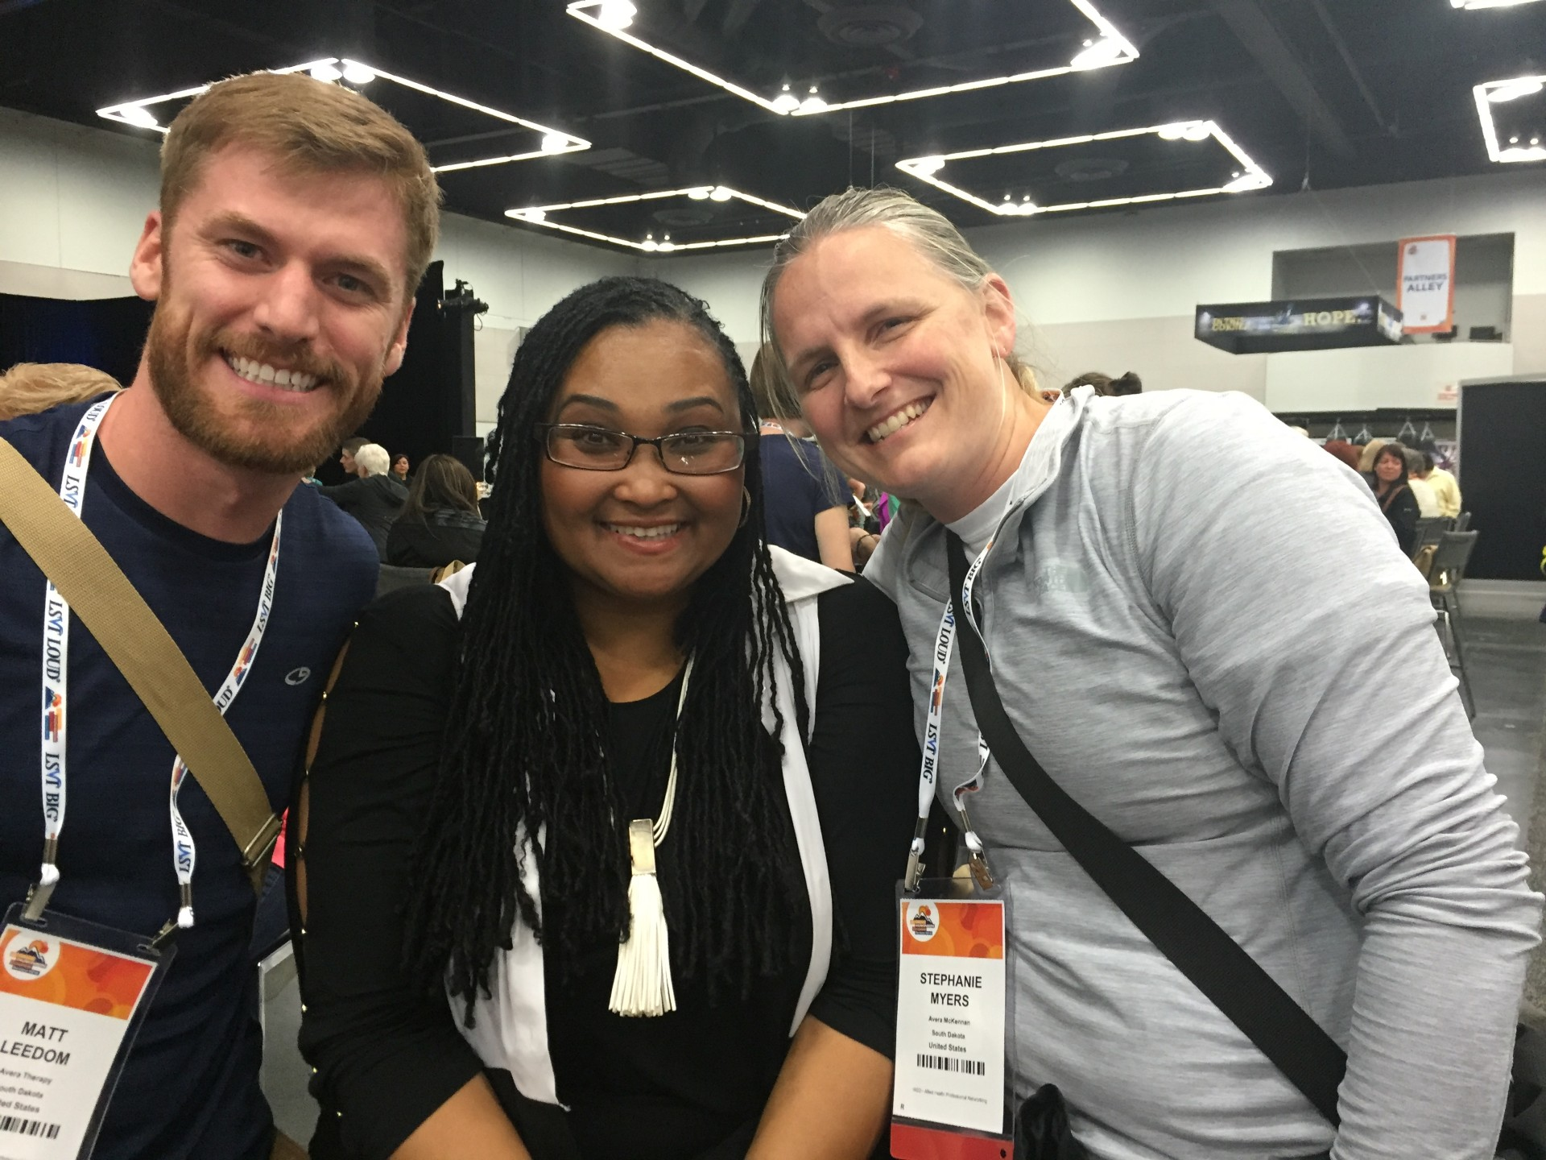

Slide 3
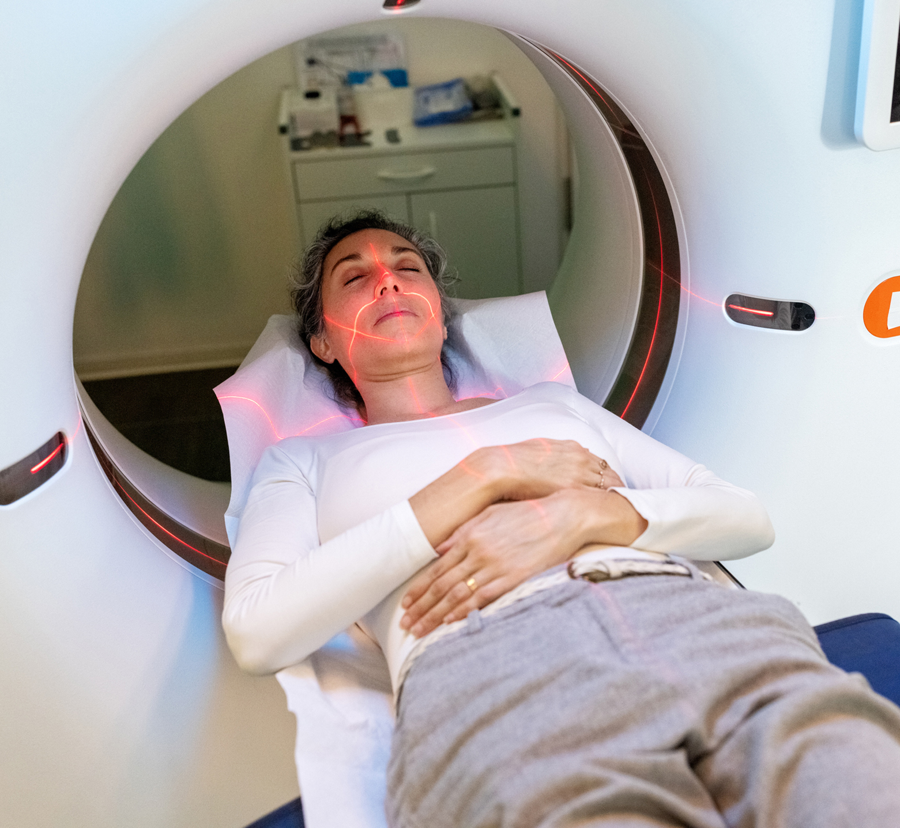
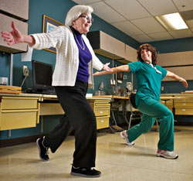
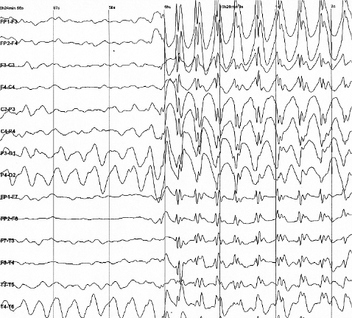
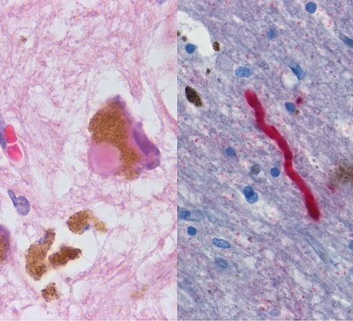
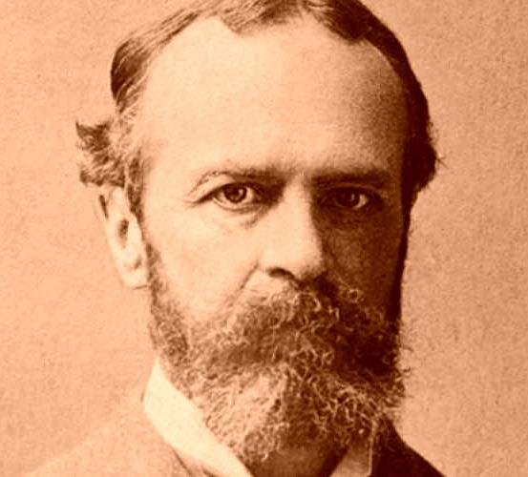
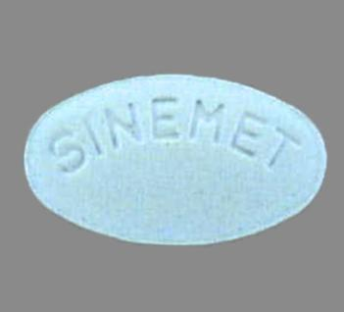

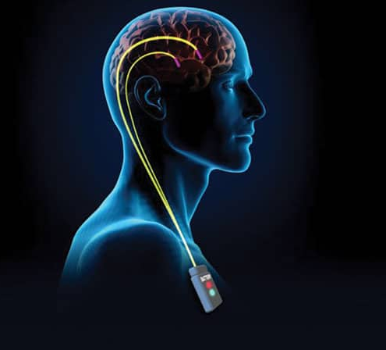
Research Milestones In PD
1817: An essay on the shaking palsy
1967: L-Dopa becomes available
1983: PD is recreated in a lab
1987: DBS first performed
1997-2000’s: Alpha synuclein + Genetics
2000 – 2010’s: Brain oscillations, imaging, biomarkers
2010’s – LSVT, exercise and rehab science
2020 – Neuromodulation and precision medicine

Slide 4
Have you ever participated in research?
Have you ever benefited from a medication or therapy?

Slide 5
Stages of Research
Scientific discoveries
Researchers attempt to understand what goes wrong in PD and suggest solutions
Developing treatments
Teams turn these problems into potential treatments
Clinical trials
Potential treatments that have been proven safe and effective by all other methods are carefully tested in study participants

Slide 6
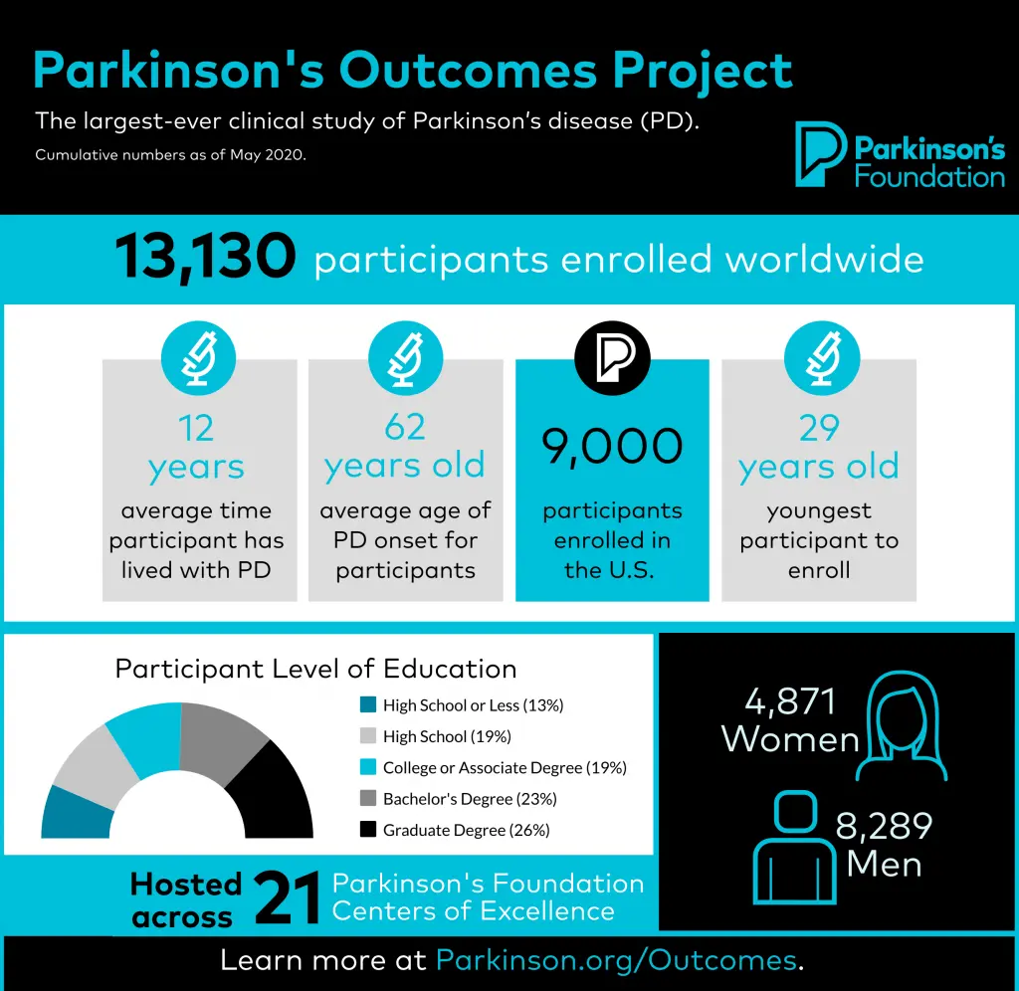
Types of Studies
Observational studies
  Do not test drugs or treatments
  Might involve surveys, imaging, blood tests, etc.
  Ex: Parkinson’s Outcomes Project
Interventional trials (Clinical Trials)
  Test a drug, therapy, or other form of treatment solution that is experimental

Slide 7
Clinical Trials Participation
Clinical trial participation benefits:
  Researchers
  Clinicians
  PwPD
More participation = treatments available faster
Slow rate of recruitment delays research
Some therapies are very promising;
Some may not be;
Treatments need to be tested to know if they will be helpful

Slide 8
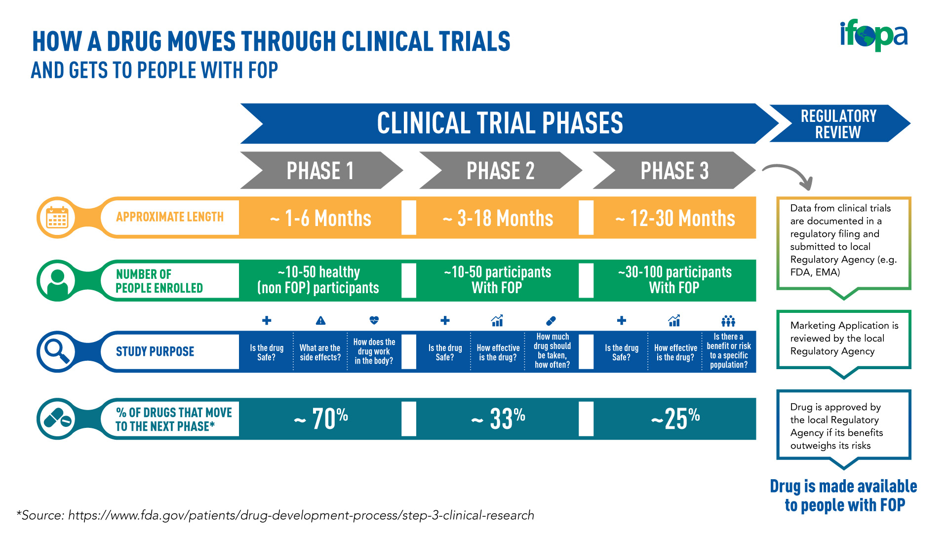

Slide 9
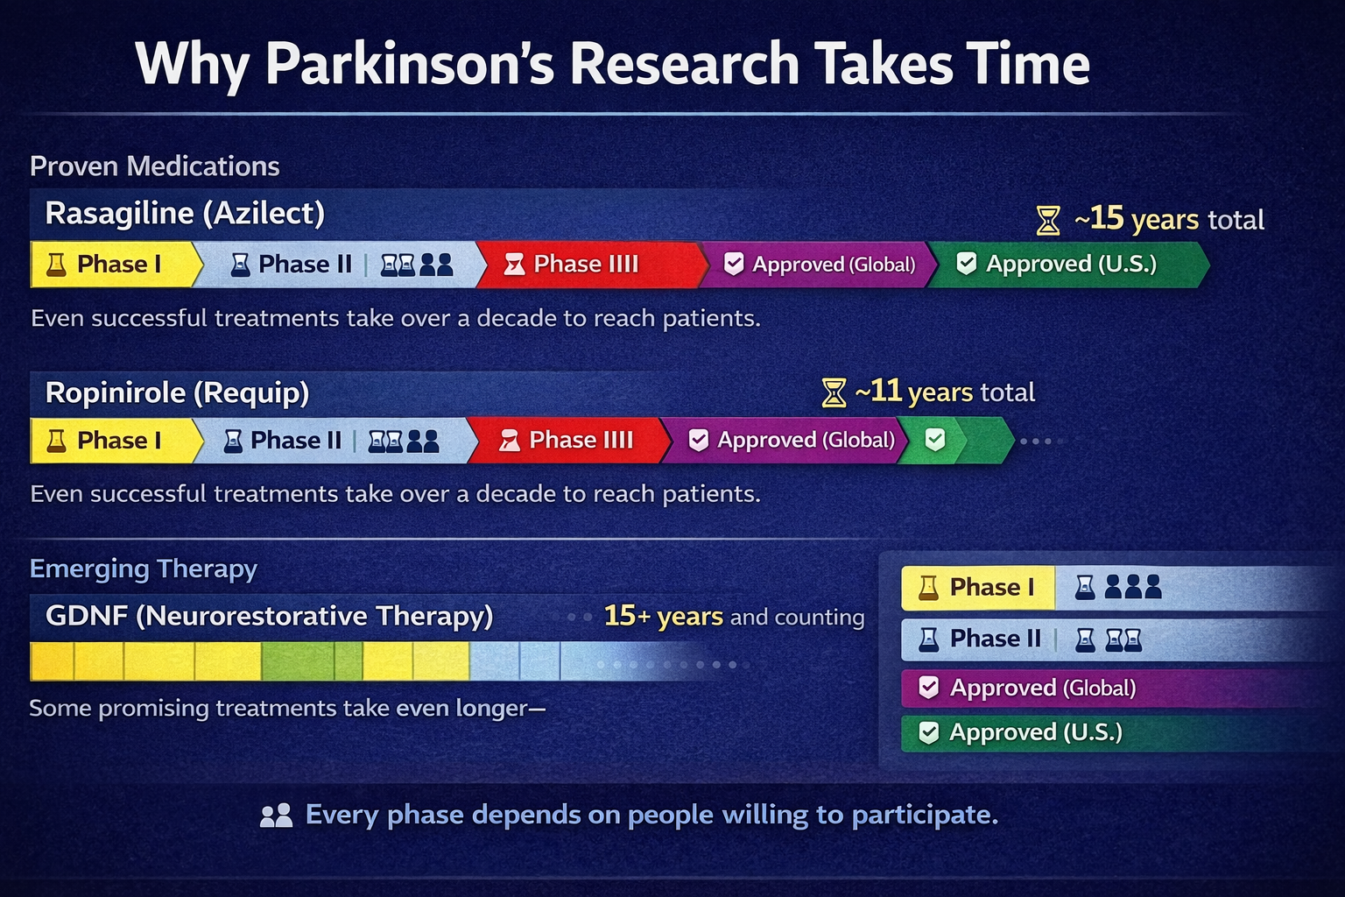

Slide 10


Slide 11

Who Can Participate in Clinical Trials?
Clinical trials vary, so many types of volunteers are needed
  PwPD
    Different trials, identify different types of PwPD
  People who do not have PD
    Carepartners
    Family members
    Others

Slide 12

How Can You Participate in Research?
Thinking about volunteering for a clinical study means weighing the potential benefits and risks
  Participation can be empowering and provide access to experts and latest treatments
  It can also expose you to risk, side effects, or discomfort
Discuss your thoughts with your family, care partner, or doctor
Talk to the research trial team about the requirements

Slide 13

Questions to Ask When Considering Research
  What are the requirements for participating?
  Are there any direct benefits?
  What are the risks?
  Who can see my data?
  Will results be shared?

Slide 14
How Can You Participate in Research?
Become a research advocate
  PD Foundation Research Advocates Program
    Trains PwPD and carepartners to partner with scientists and improve how PD research is designed and conducted.
    Advocates help prioritize research needs, make studies more practical and patient-centered and educate their communities about participating in Parkinson’s research.
    Anyone with PD or a care partner can apply by completing Foundation-led training.
  Contact your elected officials and policy makers
    National Plan to End Parkinson’s Act signed into law 2024

Slide 15
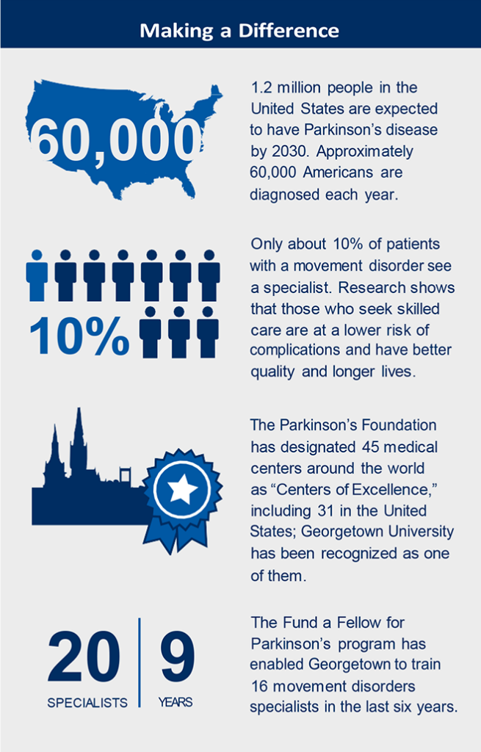
How Can You Participate in Research?
Donate to organizations that support research!
Many organizations offer research support:
  Grants
  Fellowships
  Partnerships
  PD Foundation: Reach Further campaign
  Michael J Fox Foundation
  American Parkinson’s Disease Association

Slide 16

How Can You Participate in Research?
Participate in national or local research projects
  PD Foundation: PD GENEration
  Michael J Fox Foundation: Fox Trial Finder
  National Institutes of Health (clinicaltrials.gov)
  Research Match (researchmatch.org)
  Talk to your neurologist about local opportunities

Slide 17
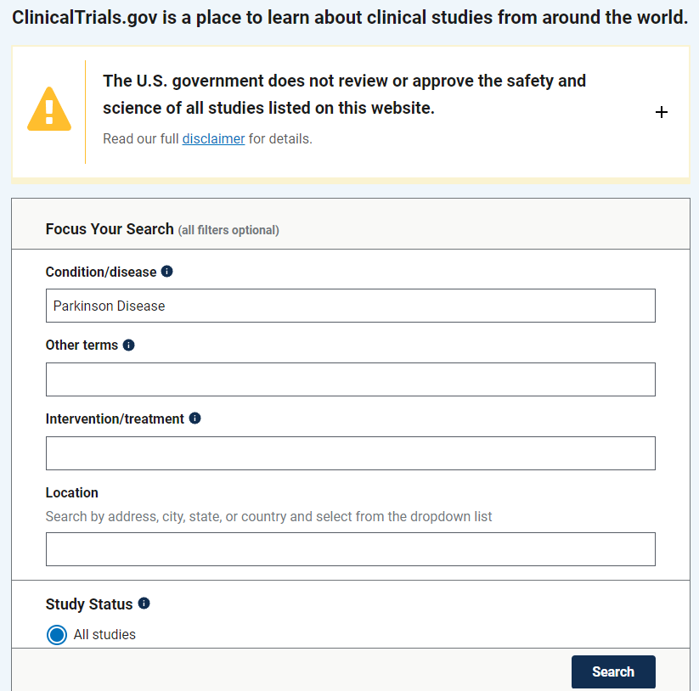
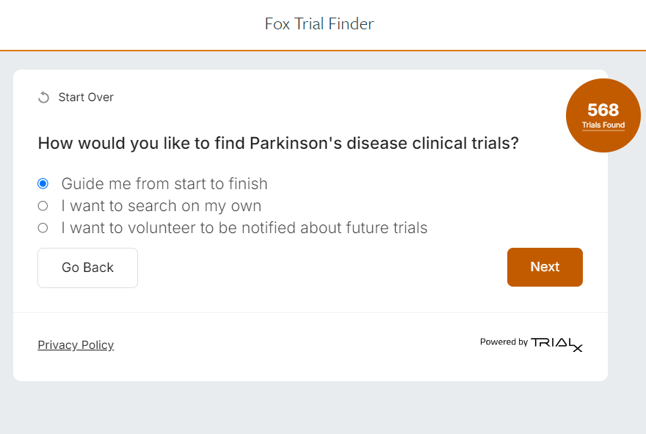

Slide 18
How Can You Participate in Research?
  Local Opportunities:
Non-Invasive brain stimulation (tACS) plus exercise
In-home non-invasive brain stimulation (tACS) plus exercise
Cerebellar non-invasive stimulation (TMS)
  Currently enrolling participants!

Slide 19
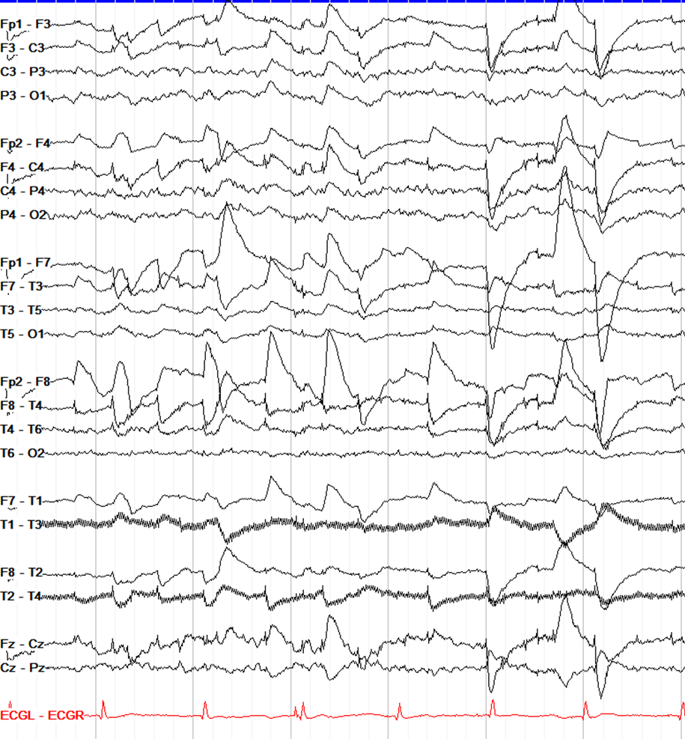
How Can You Participate in Research?
Loss of dopamine causes groups of brain cells to communicate abnormally
  Can be observed on EEG
  Motor network timing problems = movement and cognitive impairment
  Patterns can be influenced by electrical stimulation

Slide 20
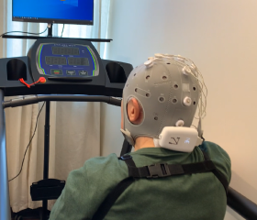
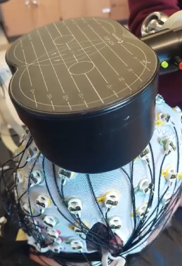
How Can You Participate in Research?
Non-Invasive Brain Stimulation =
  Transcranial Alternating Current Stimulation (tACS)
  Transcranial Magnetic Stimulation
Research Questions:
  How structured exercise changes brain signals during walking
  Whether those changes meaningfully relate to mobility improvements
  Whether we can enhance those changes using targeted non-invasive stimulation

Slide 21
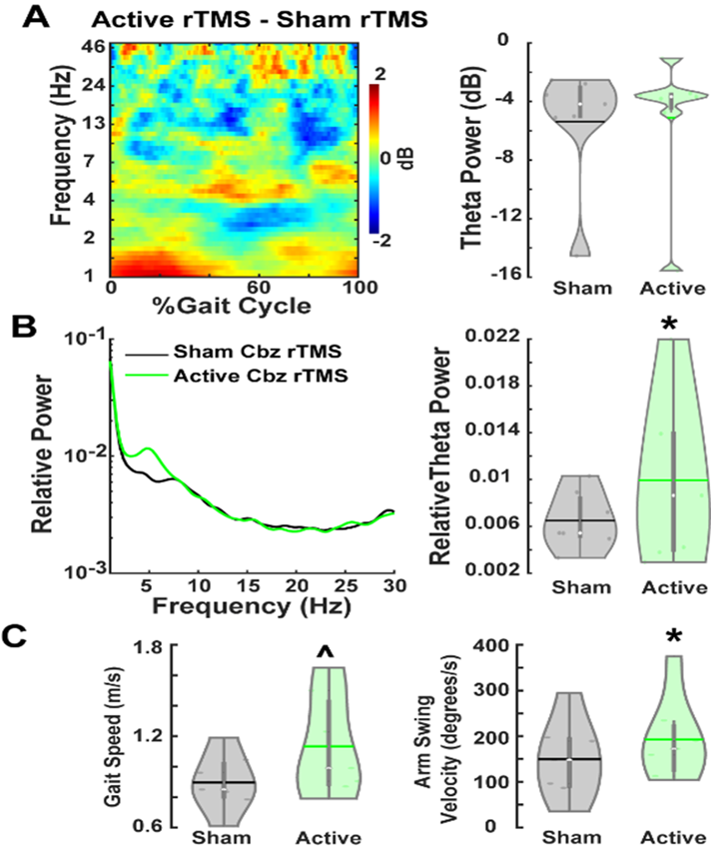
How Can You Participate in Research?
Preliminary Results:
Active rTMS enhanced theta activity compared to sham stimulation.
  Significant improvements in gait speed and arm swing velocity in PDFOG+.
tACS + exercise demonstrate improvement in gait performance
  Decrease in step asymmetry, less time in double limb support, reduction in step variability

Slide 22
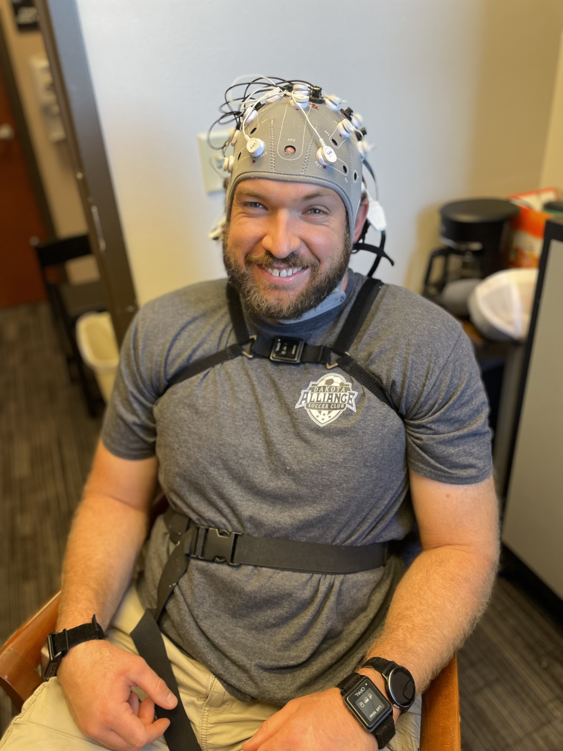
How Can You Participate in Research?
  Recruitment:
    People with Parkinson’s disease
    Healthy Controls (carepartners, family members, others)
  Exclusion:
    DBS
    Pacemaker
    History of other neurological conditions or seizures

Slide 23

Questions?
  Contact: matt.Leedom@usd.edu
Team and Acknowledgement
Singh Lab
Dr. Arun Singh, PhD
Matt Leedom, PT, DPT, NCS
MD Rezwanul Akter Pallab
Gitanjali Sattanathan (Volunteer)
Fatima Shahid (Volunteer)
Funding:
Seeds For Success
CBBRe BATS
University of South Dakota

