Slide 1


Fall Prevention-
Stand Strong. Stay Safe.
Spring Parkinson's Awareness Conference 2026
Karla Cazer, MSN, RN-BC, GCNS-BC
Amy Koenigs, OTR/L, CLT-LANA

Slide 2
Objectives
Know the main reasons people with Parkinson’s are more likely to fall.
Learn simple safety tips and daily actions that help prevent falls.
Understand basic movement strategies, exercises, and equipment that improve safe mobility.

Slide 3
Objectives
Learn easy, safe steps for getting up after a fall.
Find helpful resources and programs that support fall prevention.

Slide 4
1 in 4 adults over 65 fall each year,
with 1 in 3 falling as we reach year 85
About 20% of falls cause serious injury
Falls are the leading cause of injury-related deaths among older adults
Falls are the leading cause of Emergency Department visits for adults 65+
U.S older adult deaths from falls…….
Minnesota is #2, Iowa #6, South Dakota #12
Notes:
Older adults in the United States are increasingly dying from unintentional falls, with a significant rise in death rates over the past two decades. According to a recent report by the U.S. Centers for Disease Control and Prevention (CDC), death rates from falls have risen more than 70% for adults aged 65 to 74, over 75% for those aged 75 to 84, and have more than doubled for seniors 85 and older from 2003 to 2023. In 2023 alone, more than 41,000 retirement-age Americans died due to falls, marking about one in every 56 deaths in this age group.
Why do people die from a fall? –
- Hit head TBI, Hip fracture with related surgery and complications .
Death rates from falls vary significantly by state, with Wisconsin having the highest rates, followed by Minnesota, Maine, Oklahoma, and Vermont. Ice and wintry weather may contribute to higher rates in the upper Midwest and New England,
https://www.cdc.gov/nchs/products/databriefs/db532.htm

Slide 5
Falls in those with Parkinson’s Disease
Major source of injury, loss of independence and reduced quality of life
Estimated 50-70% of people with PD fall annually
Falls are usually Multifactorial
Research review recommends multicomponent interventions

Slide 6

Feels unsteady when standing or walking?
Worries about falling?
Has fallen in past year?
How many times?
Were you injured?
Three Key Questions
Stay Independent Questionnaire
12 Questions Scored
https://www.cdc.gov/steadi/pdf/STEADI-Algorithm-508.pdf
Center for Disease Control, 2023. STEADI. https://www.cdc.gov/steadi/index.html
Notes:
Karla
3 questions -Patient is at risk if YES to any one question
Stay Independent- score of 4 or more at risk for falling

Slide 7

Common Modifiable Fall Risk Factors
Reduced muscle strength
Gait or balance problems
Medicatons with certain side effects
Presence of home hazards
Vision or Hearing concerns
Feet or footwear issues
Vitamin D deficiency

Slide 8
Parkinson’s Specific Reasons for Falling
Walking changes
Movement and reflex issues
Freezing
Low Blood Pressure or Orthostatic Hypotension
Medication Side Effects

Slide 9
Parkinson’s Specific Reasons for Falling
Muscle Weakness –if reducing activity
Thinking Changes – Focus
Vision and Perception issues

Slide 10
Predictors of Falls in Parkinson’s Disease
Falls in the previous year
Freezing of gait in the past month
Slow gait speed
Notes:
Falls in the previous year – highest predictor
Freezing of gait in the past month – 2nd
Slow gait speed – 3rd
Absolute fall probability in the next 6 months
Low – none of the 3 =17%
Medium – with one of these = 51%
High – with 2-3 of these = 85%

Slide 11

Safety tips and daily actions to prevent falls
Keep
Keep a Fall Diary
When, Where, Why, Injury – report patterns to care team
Engage in
Engage in regular strength & balance exercises
Practice
Practice safe functional tasks frequently

Slide 12
Safety tips and daily actions to prevent falls
Home Assessment & Modifications
Medication Review & Adjustments
Identify if cause dizziness, decrease in blood pressure, increased sedation

Slide 13

Safety tips and daily actions to prevent falls
Vision exam
Hearing exam
  WEAR your hearing aids if you need them
Foot care and appropriate shoes
Vitamin D if needed

Slide 14

Common Environmental Contributors of Falls
Trip hazards
Poor lighting
Bathrooms
Footwear
Stairs
*Consider a home safety assessment

Slide 15
Practical Home Considerations
Remove rugs and clutter
Increase lighting
Add grab bars, non-slip rugs, other equipment
Wear supportive shoes
Add railings, ramp

Slide 16
Assistive Devices
Appropriate device
Needs to be fit properly to individual
Trained on device
Fall risk increases as the number of risk factors increases.

Slide 17
Exercise
Balance challenging
Progressive resistance training
Functional training

Slide 18
If You Fall: How to Get Back Up Safely
Demonstration
Tips to reduce freezing:
  Count out loud
  Use cues

Slide 19
Parkinson’s Disease Specific Therapy & Exercise
LSVT Loud and LSVT Big www.lsvtglobal.com
SpeakOut www.parkinsonvoiceproject.org
PWR!Moves www.pwr4life.org
Rock Steady Boxing www.rocksteadyboxing.org
MDT Education Solutions www.mdteducationsolutions.com
Not all inclusive list

Slide 20
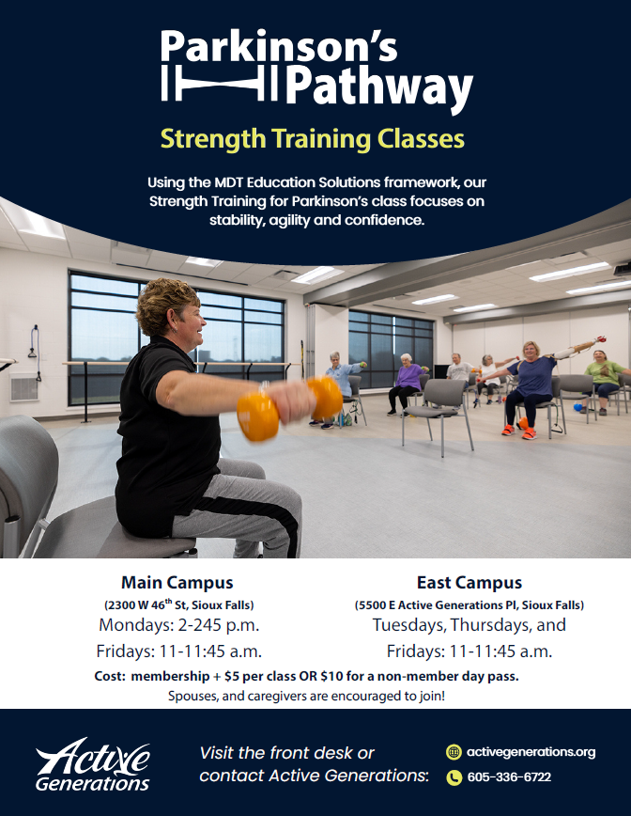

Slide 21
Evidence-based Fall Prevention Programs
Bingocize
A Matter of Balance
Stay Active & Independent for Life (SAIL)
Enhance Fitness
Stepping On
Tai Chi for Better Balance

Slide 22
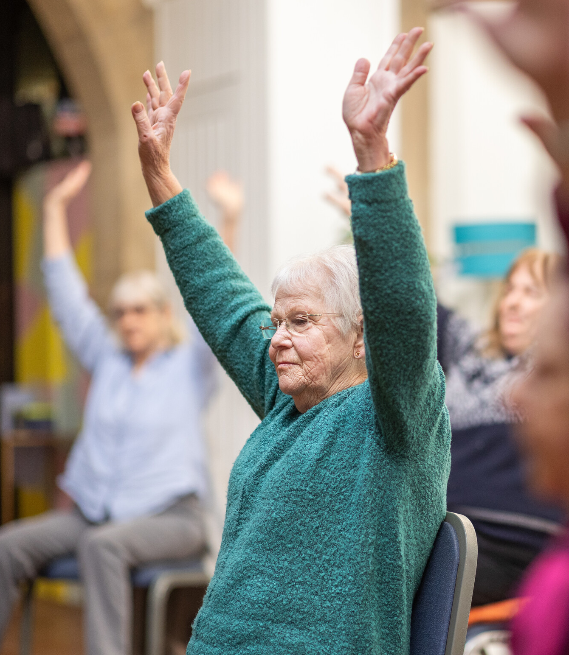
Resources
Sanford Stand Strong Fall Prevention
www.sanfordhealth.org
Keyword: balance
SD Fall Prevention Coalition
https://doh.sd.gov/programs/fall-prevention-coalition/
Speaker Contacts
  Karla.cazer@sanfordhealth.org
  Amy.Koenigs@sanfordhealth.org

Slide 23
References
Ambrose AE, Paul G, Haudorff JM. Risk Factors for Falls Among Older Adults: A Review of the Literature. Maturitas 2013;75:51-61. DOI: 10.1016/j.maturitas.2013.02.009
Allen, N.W., Canning, C.G. et al. (2022). Interventions for preventing falls in Parkinson’s disease. Cochrane Database of Systematic Reviews, 2022(8). https//doi.org/10.1002/14651858.CD011574.pub2
Center for Ageing Better, (2023). Age Positive icons and pictures. Retrieved https://ageingbetter.resourcespace.com/pages/home.php
Centers for Disease Control and Prevention, National Center for Injury Prevention and Control, (2023). Facts about falls. Retrieved https://www.cdc.gov/falls/facts.html
Garnett MF, Weeks JD, Zehner AM. Unintentional fall deaths in adults age 65 and older: United States, 2023. NCHS Data Brief. 2025;532:1‑11. Accessed April 12, 2026. https://www.cdc.gov/nchs/products/databriefs/db532.htm
Centers for Disease Control and Prevention (2023). Timed up and Go. Retrieved https://www.youtube.com/watch?v=tNay64Mab78&t=11senter for Disease Control, 2023. STEDI. https://www.cdc.gov/steadi/index.html
Centers for Disease Control and Prevention (2020). Behavioral Risk Factor Surveillance System (BRFSS) https://www.cdc.gov/brfss/annual_data/annual_2020.html
Centers for Disease Control and Prevention (2023). STEADI. Retrieved https://www.cdc.gov/steadi/index.html
Centers for Disease Control and Prevention; National Center for Injury Prevention and Control, (2017). Fact Sheet: Medications linked to falls. Retrieved https://www.cdc.gov/steadi/pdf/STEADI-FactSheet-MedsLinkedtoFalls-508.pdf.
National Council on Aging, (2023). Professionals. Retrieved https://www.ncoa.org/professionals
National Council on Aging, (2023). Evidence-based Falls Prevention Programs Risk Continuum Guidance for Program Selection. NCOA Evidence-Based Falls Prevention Programs Risk Continuum
Paul, S. S., Canning, C. G. et al. (2013).Three simple clinical tests to accurately predict falls in people with Parkinson’s disease. Movement Disorders, 28(5), 655-662. https://doi.org/10.1002/mds.25404.
Stay Active and Independent for Life (SAIL), (2023). Stay Active and Independent for Life.
Western Kentucky University, (2023). Bingocize®. Retrieved https://www.wku.edu/bingocize/

