Slide 1
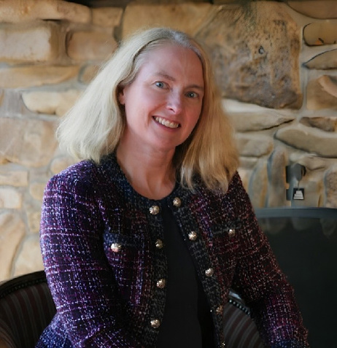
SOUTH DAKOTA PARKINSON FOUNDATION
October 2, 2026
Power the Positive
From "Oh Crap!" To Strength After a Parkinson's Diagnosis
Sara Whittingham, MD
Physician • USAFVeteran • Mom • Athlete

Slide 2
Oh Crap!
It's Parkinson's
November 2020
Age 46
Sara Whittingham, MD

Slide 3
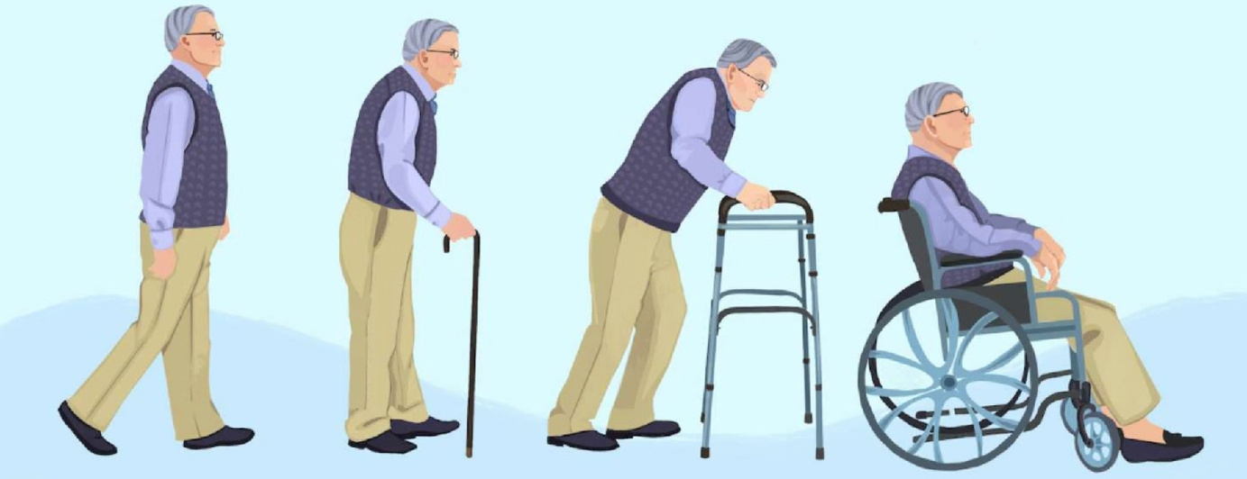
My future collapsed
Illustration via RANC Clinic
I took those images as a forecast of my entire life.
Sara Whittingham, MD

Slide 4
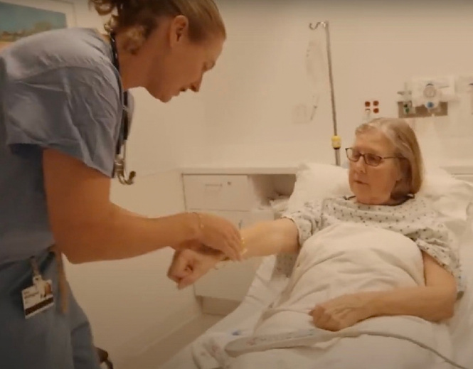
Safe to practice?
Would I recognize it?
Would I admit it?
Would someone tell me?
Sara Whittingham, MD

Slide 5
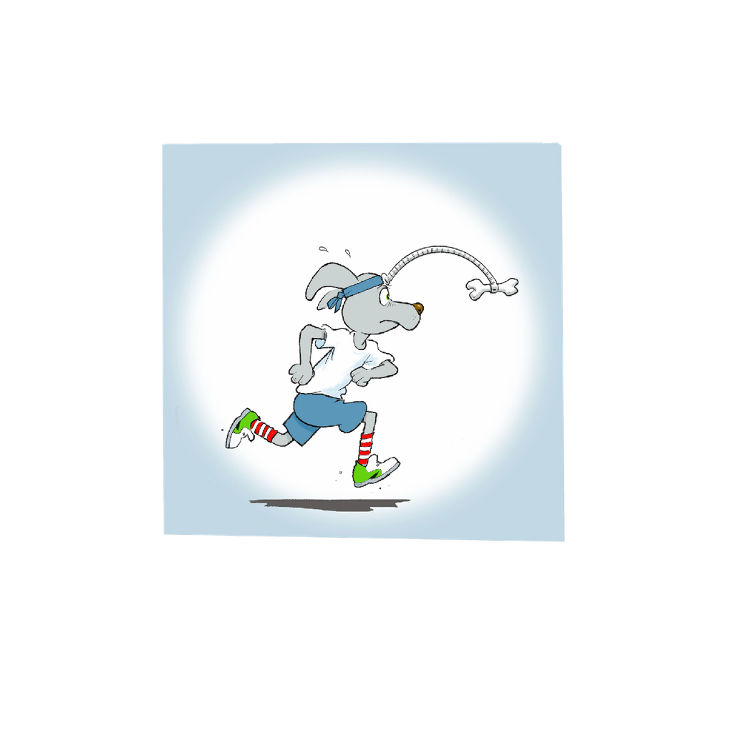
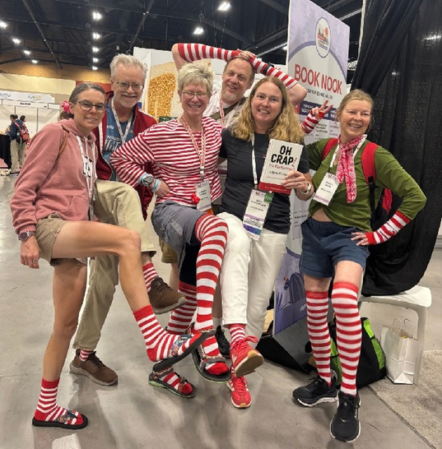
Meet Twitchy McGrit
Sara Whittingham, MD

Slide 6


A Different Picture of Parkinson's Disease
Sara Whittingham, MD

Slide 7

The red light
For the first time in a year, I acknowledged that
I was not all right.
S
SAARRAA WWHHIITTTTIINNGGHHAAMM,, MMDD

Slide 8
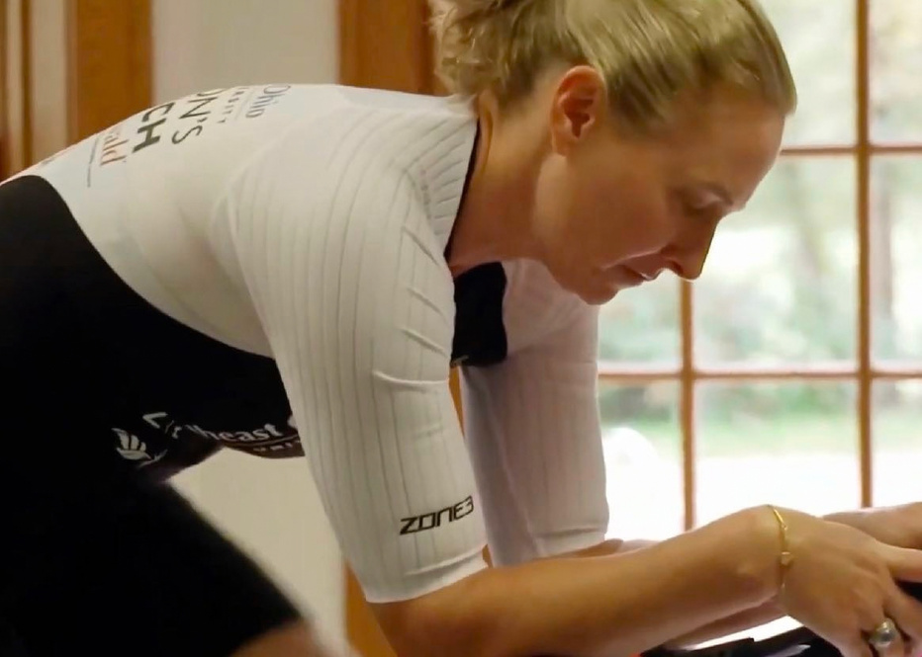
The Lifeline
Sara Whittingham, MD
06

Slide 9
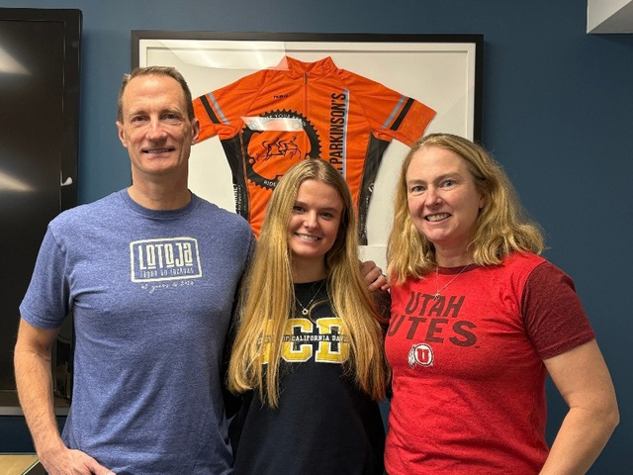
CYCLE II Trial
256 participants
12-month change in MDS-UPDRS Part III
0.2
93% adherence
3.9
Knowing hadn’t gotten me on the bike.
Alberts et al., MDS Congress 2025. Conference abstract. Higher motor scores indicate greater impairment.
Sara Whittingham, MD

Slide 10

Surprising Myself
Sara Whittingham, MD

Slide 11

A Platform
Sara Whittingham, MD

Slide 12

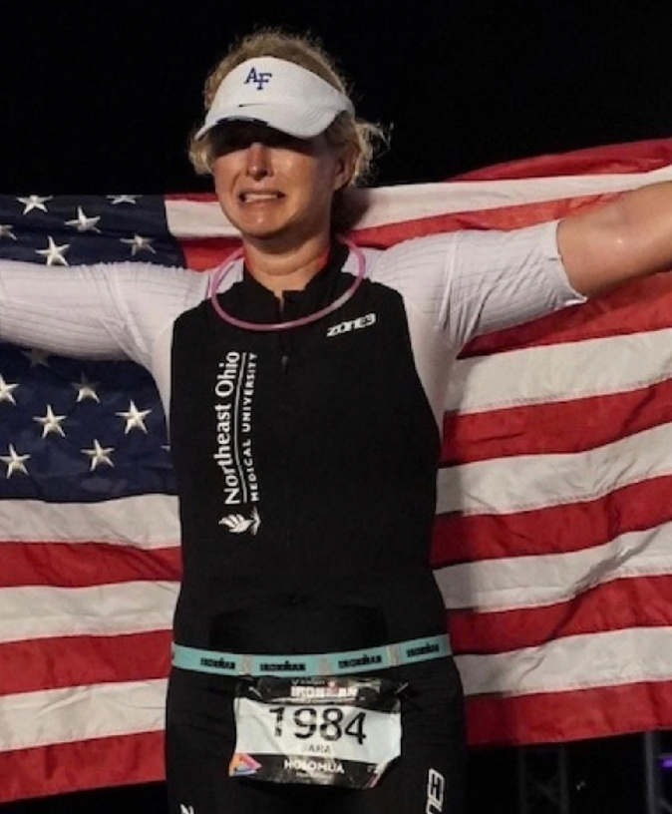

Sara Whittingham, MD

Slide 13
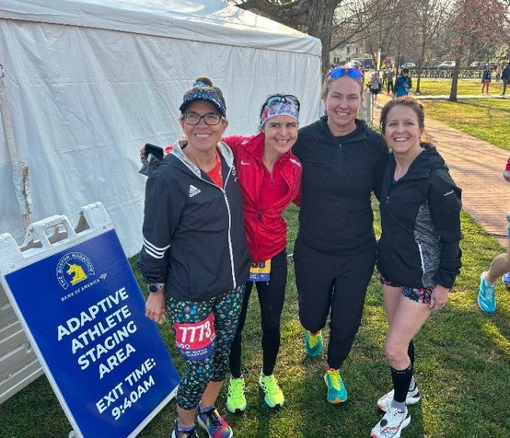

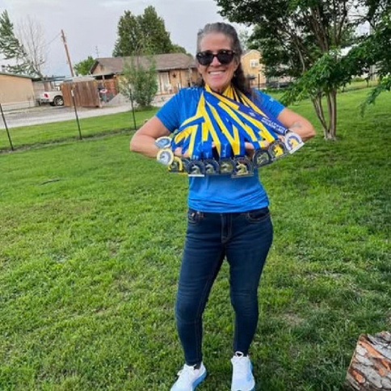
Boston Marathon
Rhonda changed my time horizon
Sara Whittingham, MD

Slide 14
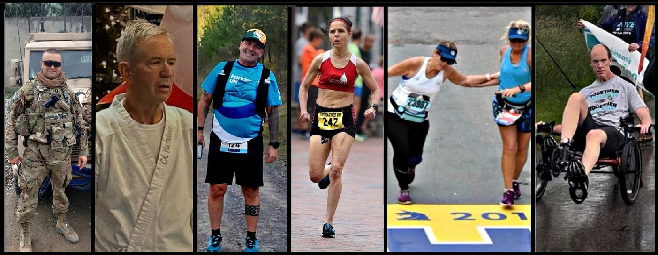
Parkinson’s progression: Sara’s version
People adapt.
Sara Whittingham, MD

Slide 15
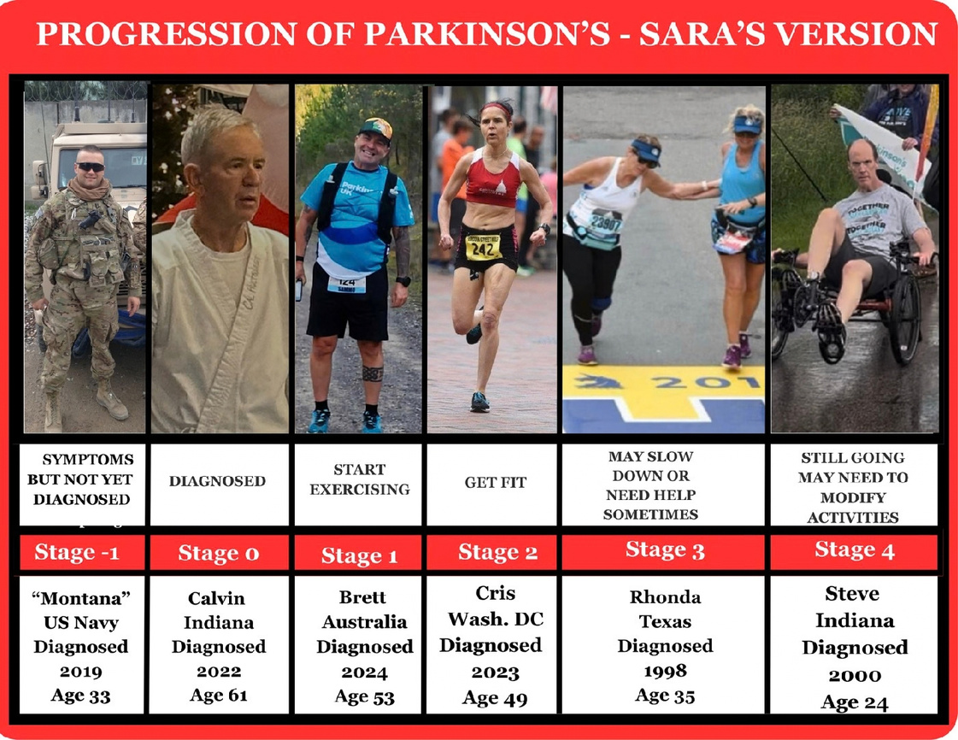

Slide 16
Parkinson’s progression: Sara’s version
Stage -1: Prior to Diagnosis
Stage 0:
The Diagnosis Tornado
Stage -1
Stage 0
Sara Whittingham, MD

Slide 17
Parkinson’s progression: Sara’s version
Stage 1: Finding a way forward
Stage 2: The Rise
Stage 1
Stage 2
Sara Whittingham, MD

Slide 18
Parkinson’s progression: Sara’s version
Stage 3: The Enduring Warrior
Stage 4: The Grace Stage
Stage 3
Stage 4
Sara Whittingham, MD

Slide 19

The book I needed
The science.
The lived experience. And pictures.
Sara Whittingham, MD

Slide 20



Keep making the lists longer
What is good
What I still want
What I have done
Gratitude List
Life List
RockStarList
Sara Whittingham, MD

Slide 21

The Epic Shit Hypothesis
This feels impossible.
What if
I could?
Sara Whittingham, MD

Slide 22

The Dangers of Bubble Wrap
Sara Whittingham, MD

Slide 23
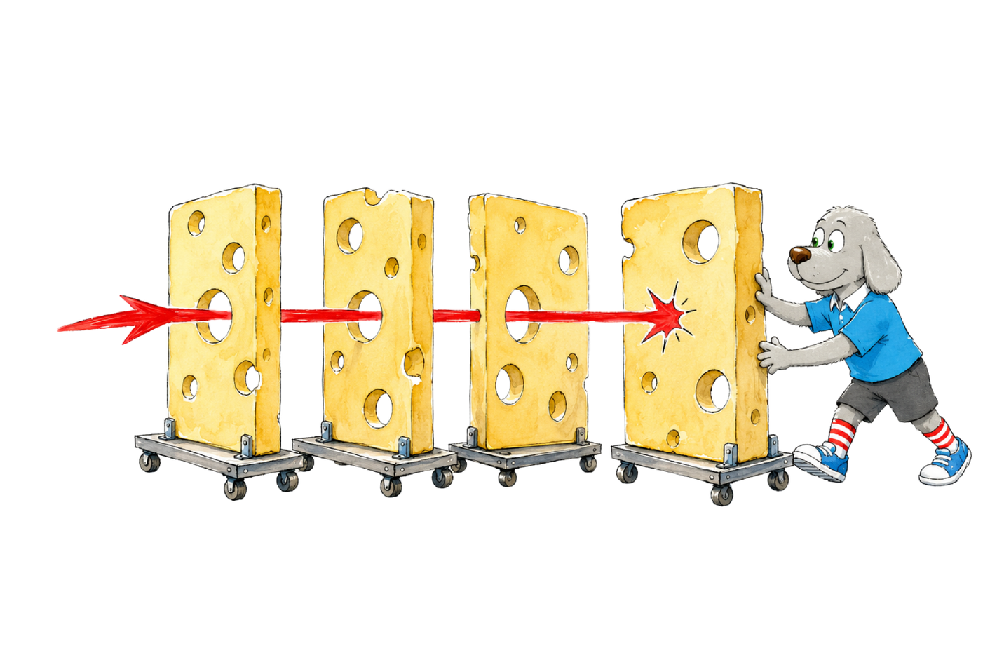
Humans make mistakes.
Build layers of protection.
Sara Whittingham, MD

Slide 24

Don’t shoot
the messenger.
Thank them.
Listen. Get curious. Decide what happens next.
Sara Whittingham, MD

Slide 25

Ask a better question
How does this end?
What can I do now?
Sara Whittingham, MD

Slide 26

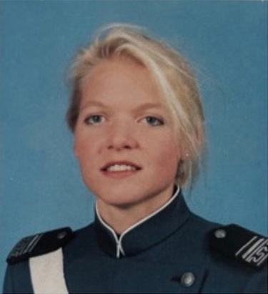

Advocacy began with Jana
Sara Whittingham
Jana Reed
Erika Neitzke
USAFA 1996
USAFA 1995
USAFA 2000
Three women. Three nearby Academy classes.
Sara Whittingham, MD

Slide 27
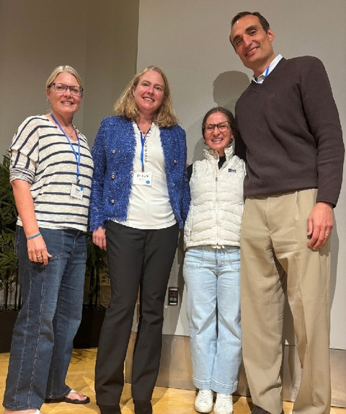
Keep asking questions
More than
6,000
post-9/11veterans filed Parkinson’s claims
Camp Lejeune cohort
70% higher odds of Parkinson’s
Adjusted OR 1.70(95% CI1.39–2.07)
Claims: Sara’s FOIA findings. Cohort: Goldman et al., JAMA Neurology, 2023.
Sara Whittingham, MD

Slide 28
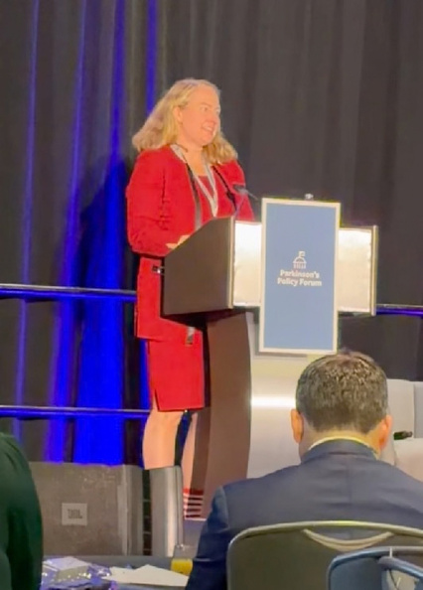
A seat at the table
Research. Care. Services.
Crew Resource Management on a much larger scale.
Parkinson’s Policy Forum
Sara Whittingham, MD

Slide 29

Sara Whittingham, MD

Slide 30
REFERENCES
Selected evidence
Exercise
AlbertsJL, Rosenfeldt AB, Lopez-Lennon C, et al.
An Exercise Prescription to Slow the Progression of Parkinson’s Disease. MDS Congress 2025. Movement Disorders. 2025;40(suppl 1).
Conference abstract
Military exposures
GoldmanSM,WeaverFM, Stroupe KT, et al.
Risk of Parkinson Disease Among Service Members at Marine Corps Base Camp Lejeune. JAMA Neurology. 2023;80(7):673–681.
doi:10.1001/jamaneurol.2023.1168
Sara Whittingham, MD

